Slide 1
Tales from Pavlysh:
A World of Beauty
Stories by Vasyl Sukhomlynsky
Translation by Alan Cockerill
Presentation 1:
Illustrations by year 3 & 4 students
from Ukraine, Russia and Belarus

Slide 2
The stories and the pictures
The stories in this presentation are all written by Vasyl Sukhomlynsky, a dedicated teacher and school principal who taught at a school in the Ukrainian village of Pavlysh from 1947 to 1970. Most of Sukhomlynsky’s books are written for teachers, but he also wrote many little stories for children. He used these stories to illustrate important values. A selection of 19 stories, all about the beauty of nature, have been published in the picture book Tales from Pavlysh: A World of Beauty.
(The text of these stories is subject to copyright, and may not be used for commercial purposes without the permission of EJR Language Service Pty. Ltd. It is, however, permitted to freely circulate this presentation to schools.)
The pictures in this presentation were entered in a competition to illustrate the 19 stories. Thousands of children, mostly from Ukraine, sent in their entries. Only 23 of the pictures could be used in the book Tales from Pavlysh: A World of Beauty, and it was very difficult to choose them from all the beautiful pictures that were sent in. This presentation, and the other three that go with it, are designed to show Australian children more of the competition entries. It is hoped that Australian children will be inspired to create some beautiful pictures of their own. The illustrations in this first presentation are by students in years 3 & 4. Other presentations contain pictures by students in years 5 & 6, 7-9, and 10 & 11.

Slide 3
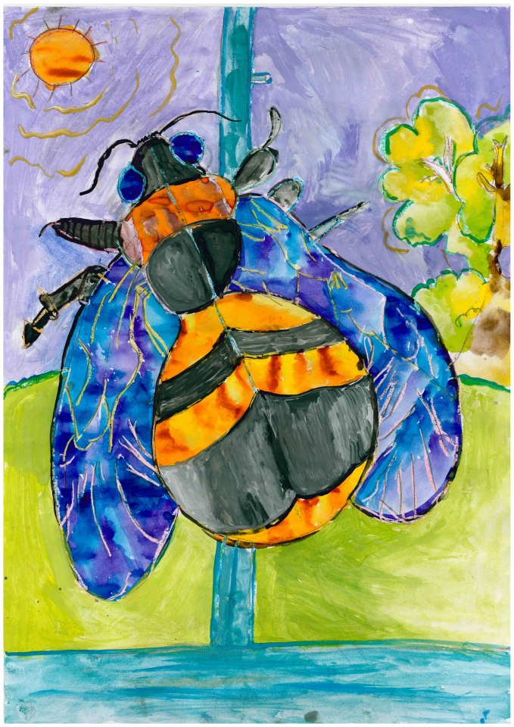
How can the Bumblebee get out?
A bumblebee, yellow and furry, flew into the classroom. For a long time it flew around and then it flew over to the window. It beat against the glass and cried, but it could not get out.

Slide 4
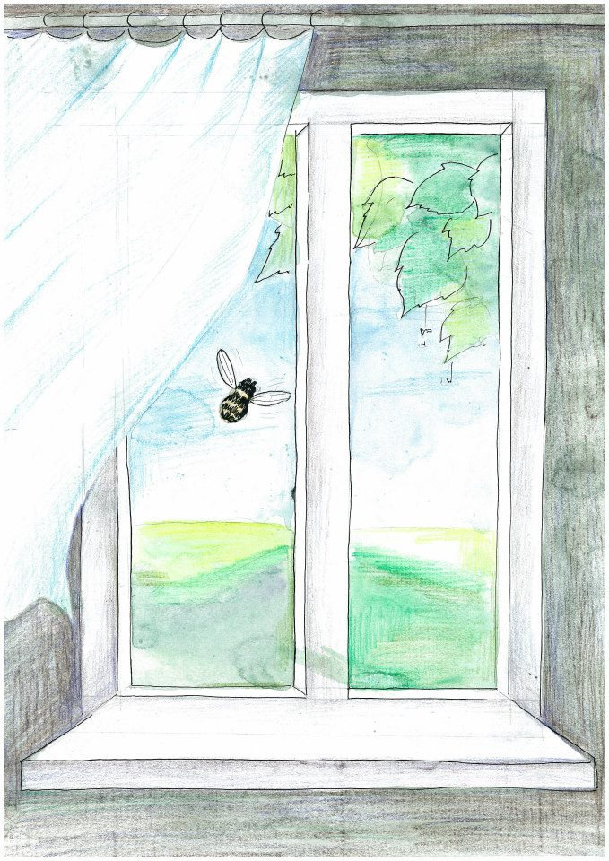
When the children arrived at school, the bumblebee was quietly crawling across the window pane. Sometimes it tried to fly, but it had no strength left.
The bumblebee was crawling over the glass. Nobody took any notice of the poor bumblebee, except for Nina, the smallest girl in the class, who stared at it all the time.

Slide 5
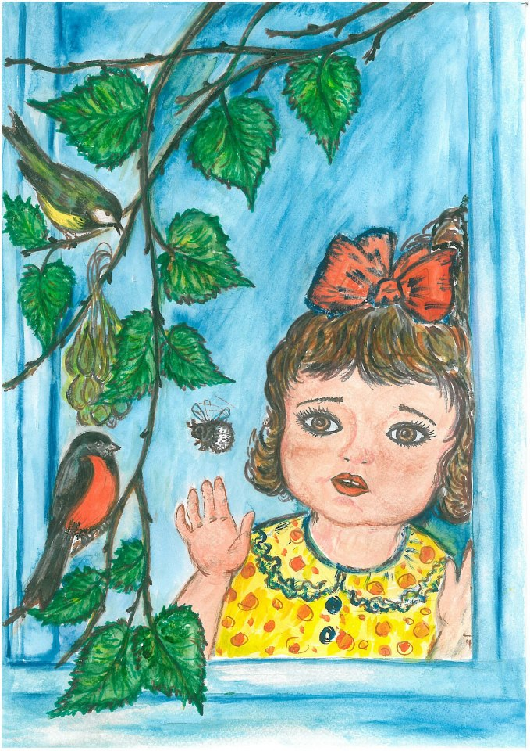
Nina wanted so much to go up to the bumblebee, to take it in the palm of her hand, to lift it up to the open ventilation window, and let it out.
Nina could not wait for the break.
If only the time would go faster.
If only the bell could ring sooner.

Slide 6
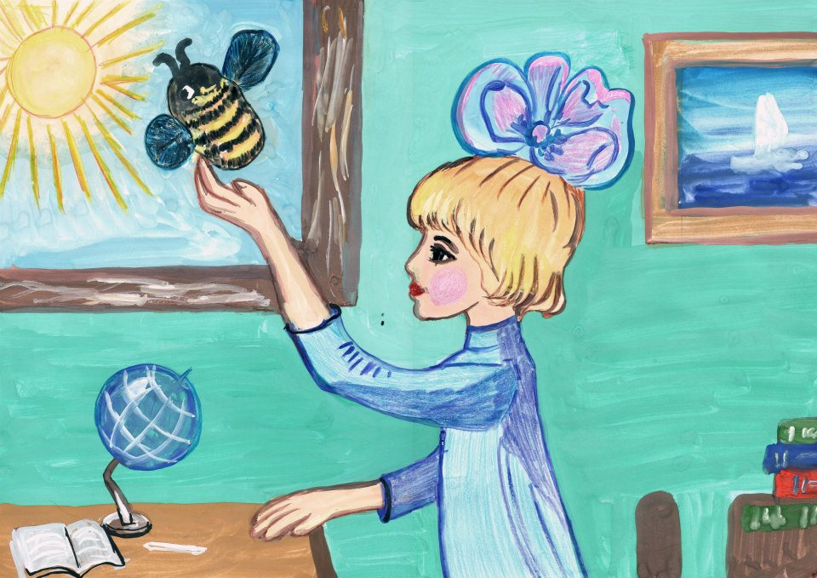

Slide 7
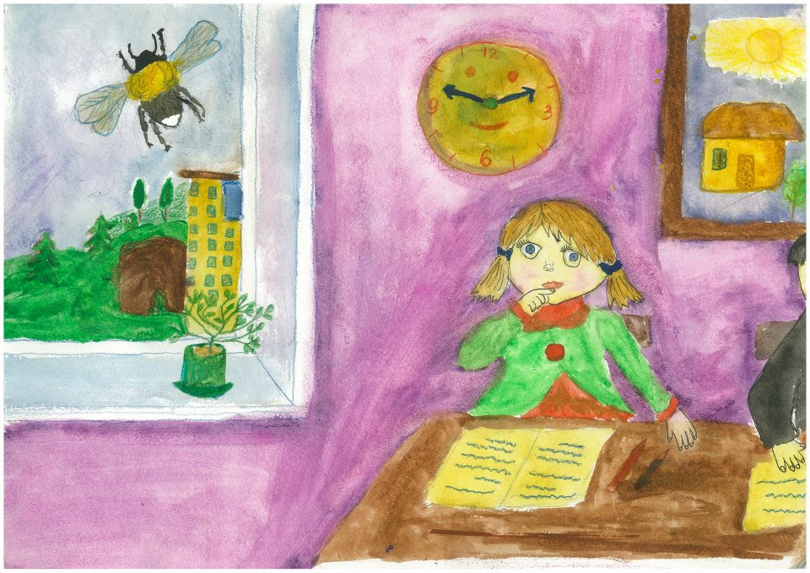

Slide 8
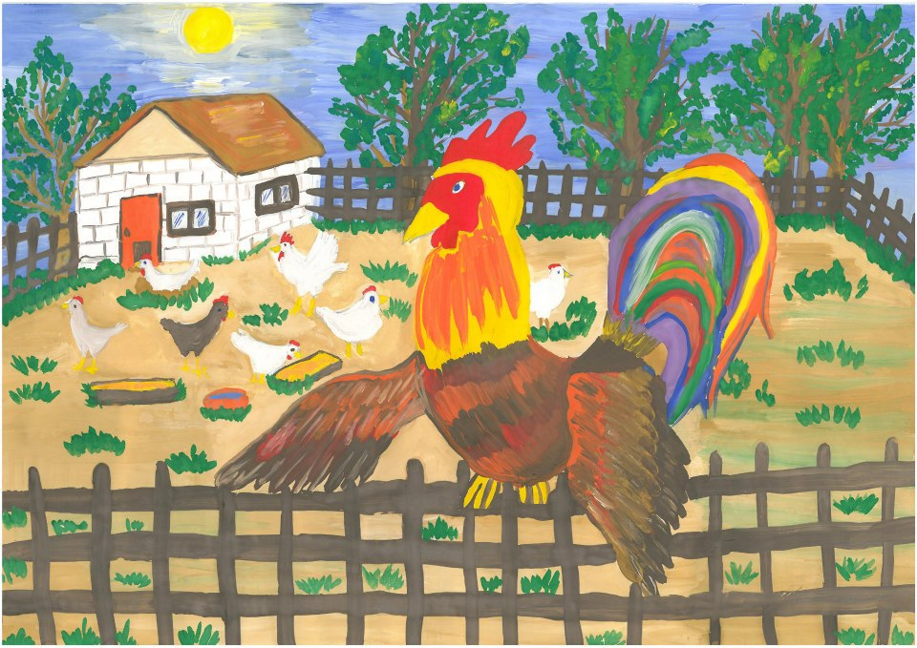
Why the Rooster has a Comb
Our rooster has a red comb. At night, as soon as the hens settle on their roost, he takes his comb and brushes his many-coloured tail. That is why his tail is so magnificent.

Slide 9
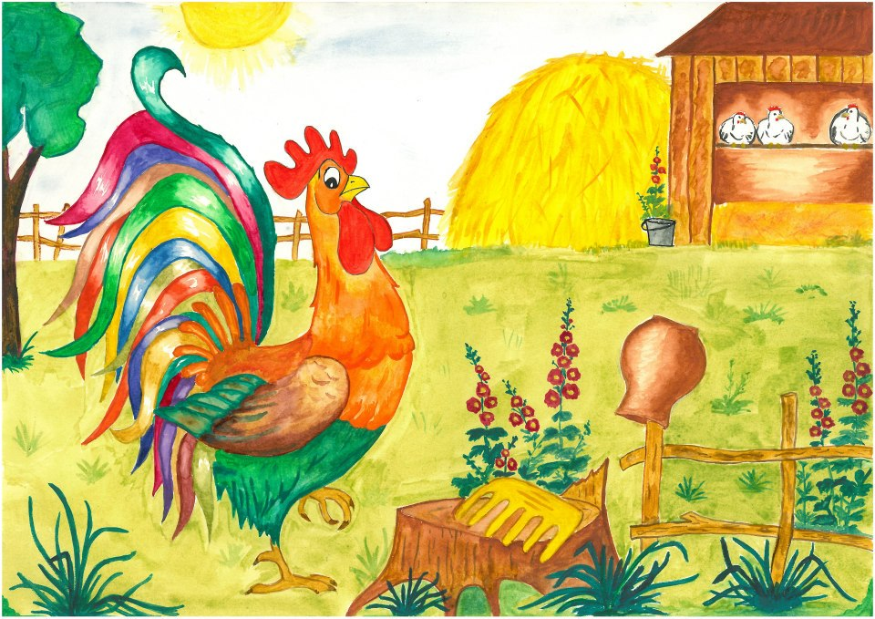
He brushes his tail and puts his comb back on his head. Then during the day he walks around, showing off.

Slide 10
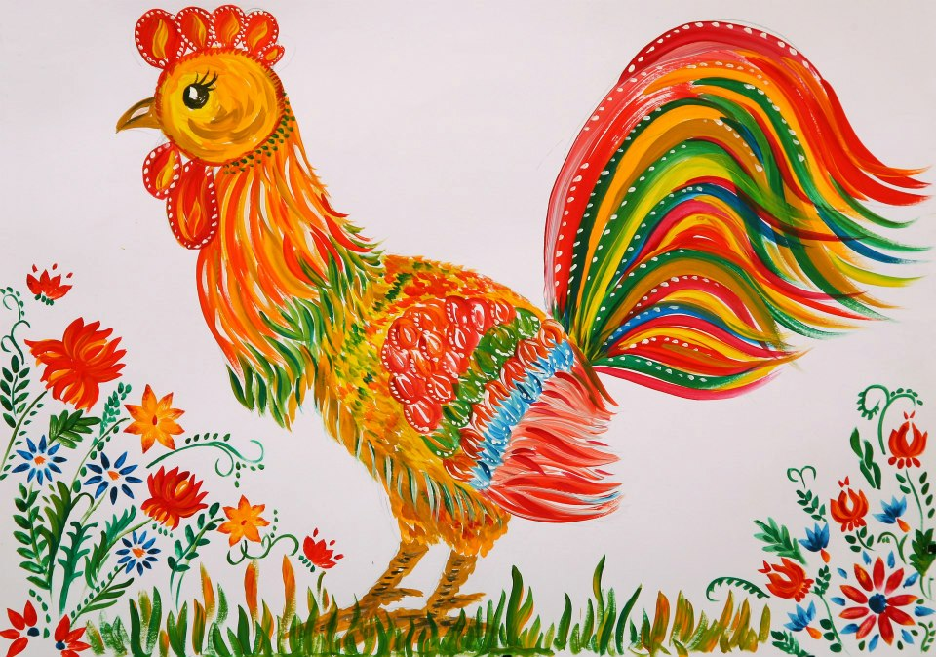
This image was chosen for the back cover of the book.

Slide 11
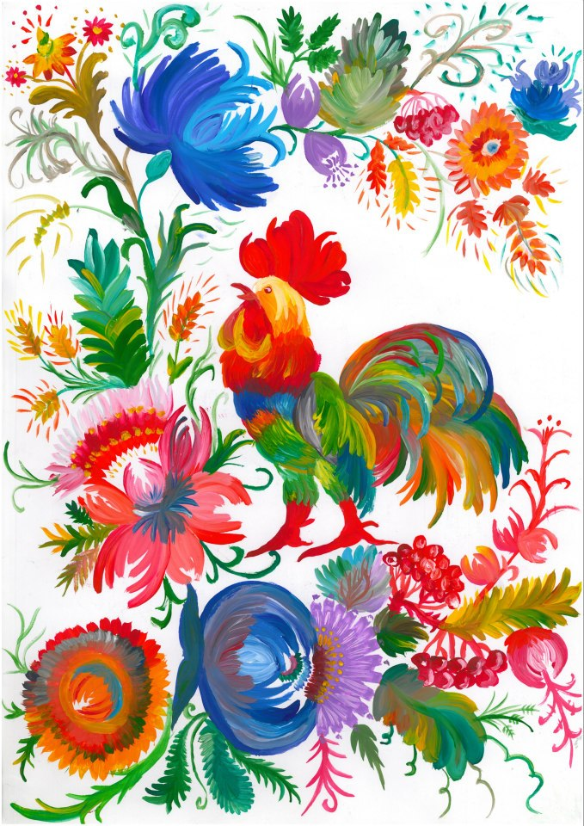
This image was chosen for the front cover of the book.

Slide 12
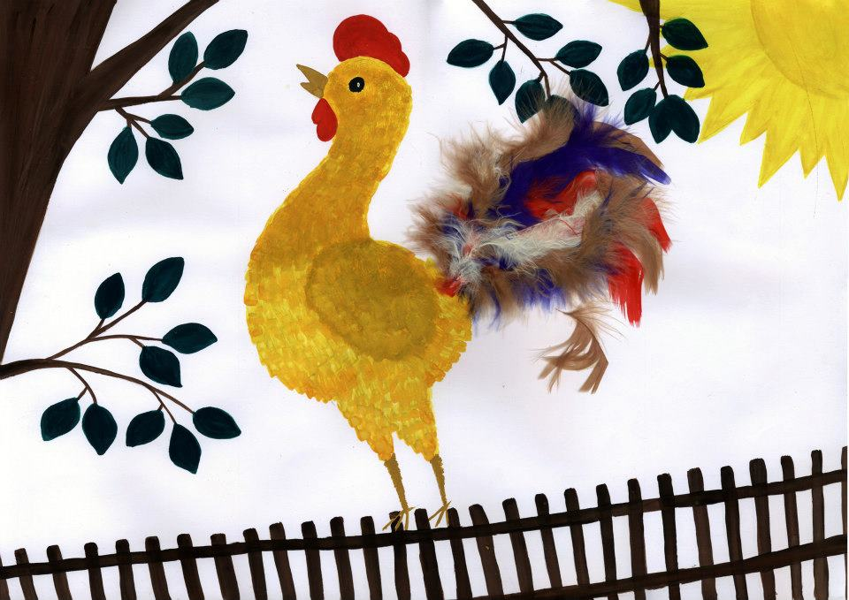
Altogether, about 350 illustrations were submitted for this little story.

Slide 13
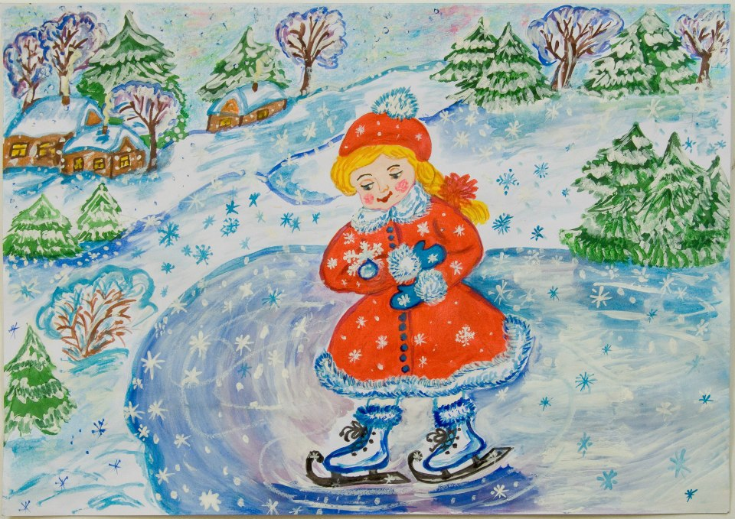
The Snowflake and the Drop of Water
Alyonka is running over the ice. Snowflakes are falling, floating in the air. One snowflake settles on Alyonka’s sleeve. Alyonka looks at the fluffy snowflake. It is a six-pointed star, so beautiful and shiny that a fairy-tale master might have cut it from a plate of silver.

Slide 14
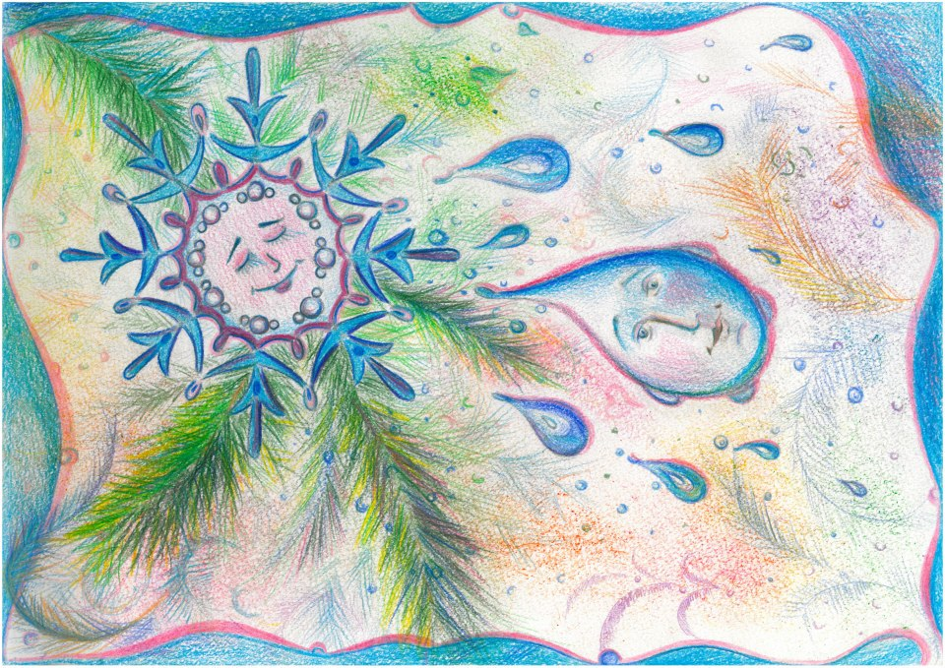
Alyonka bends her face to the snowflake, studying it, admiring it. Suddenly a miracle happens. The snowflake turns into a drop of water.

Slide 15
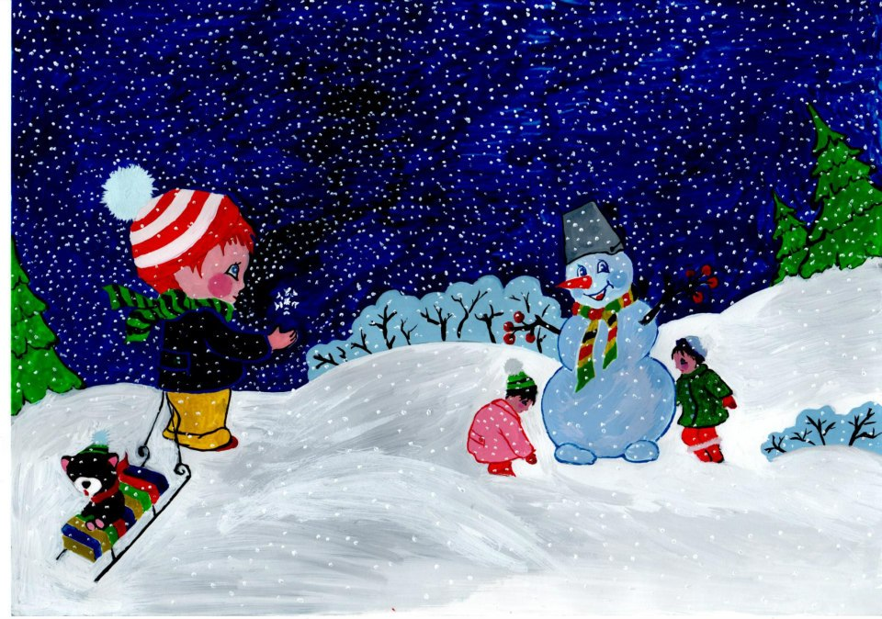

Slide 16
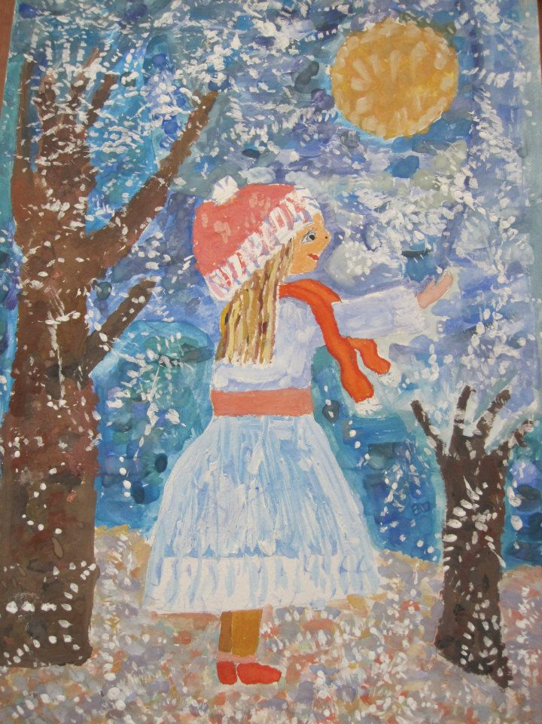
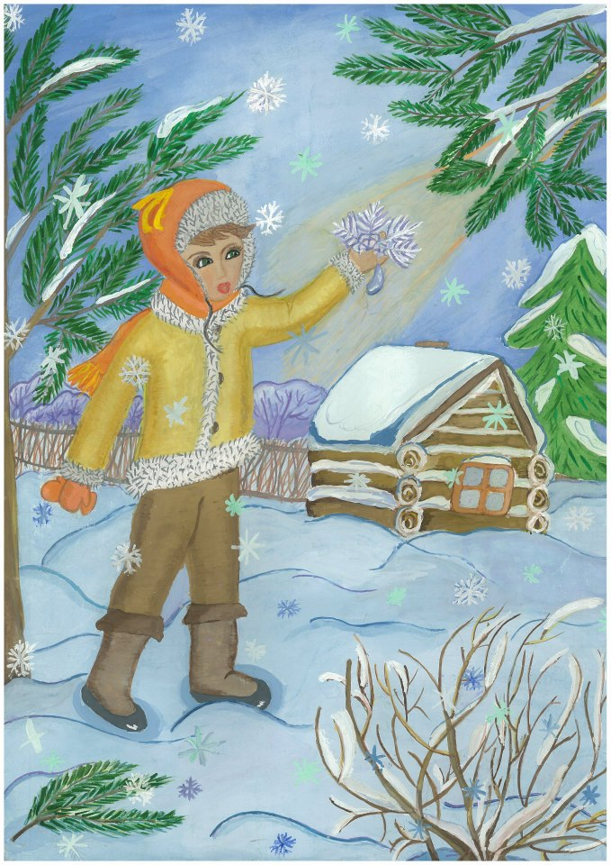

Slide 17
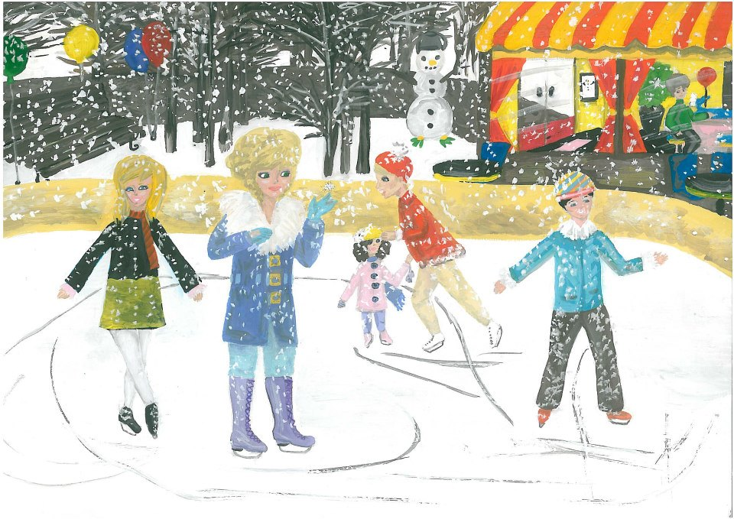

Slide 18
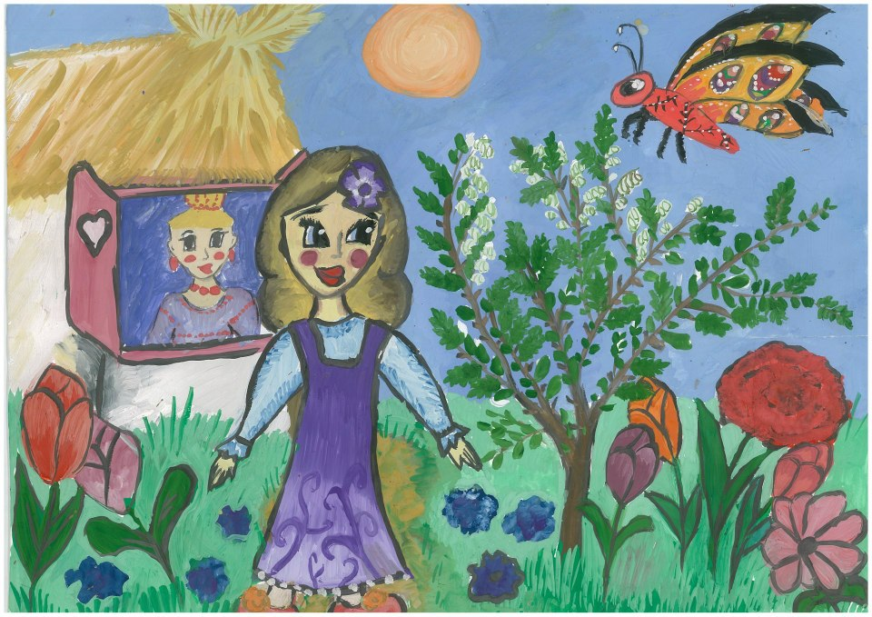
So the Butterfly will not Prick Itself
Little Zoya was walking in the garden. She went up to the acacia. On the acacia were very sharp thorns.
A brightly coloured butterfly was flying above the acacia. “Oh!” thought Zoya. “It is dangerous to fly there! What if it flies onto the thorns?”

Slide 19
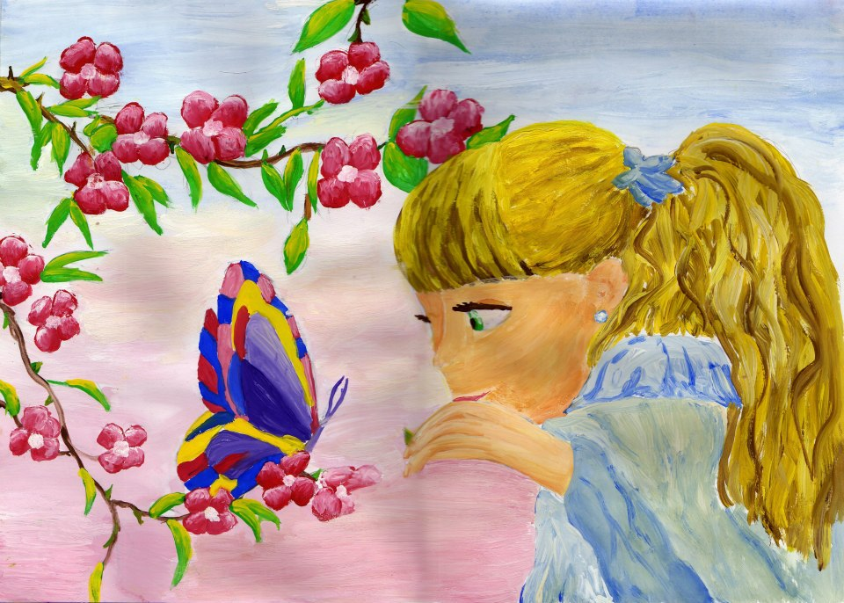
Zoya stepped up to the acacia. She broke one thorn, then a second, then a third. Her mother saw her and asked: “What are you doing, Zoya? Why are you breaking off the thorns?”
“So the butterfly will not prick itself,” answered Zoya.

Slide 20
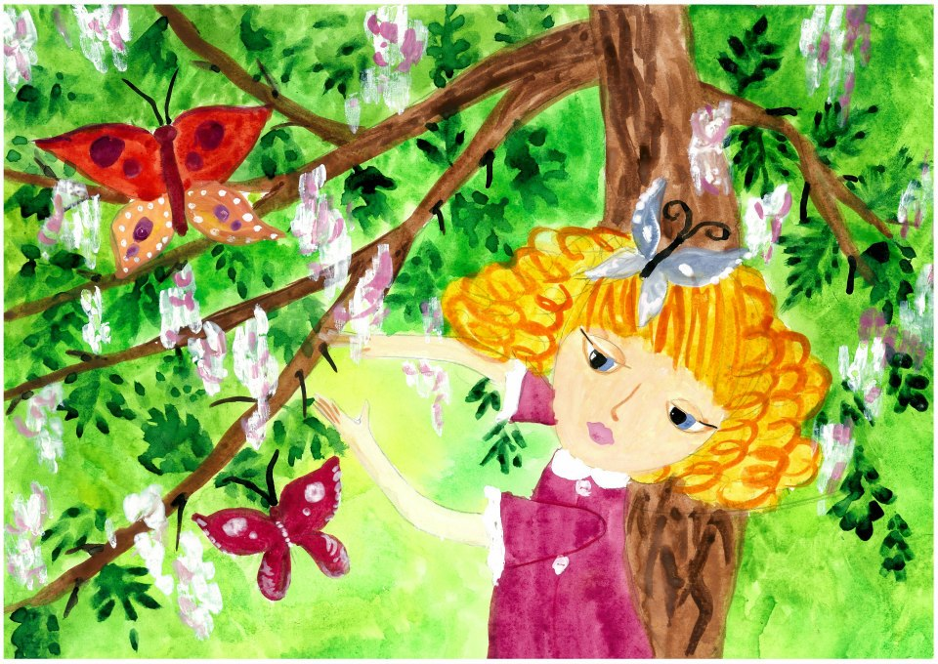

Slide 21
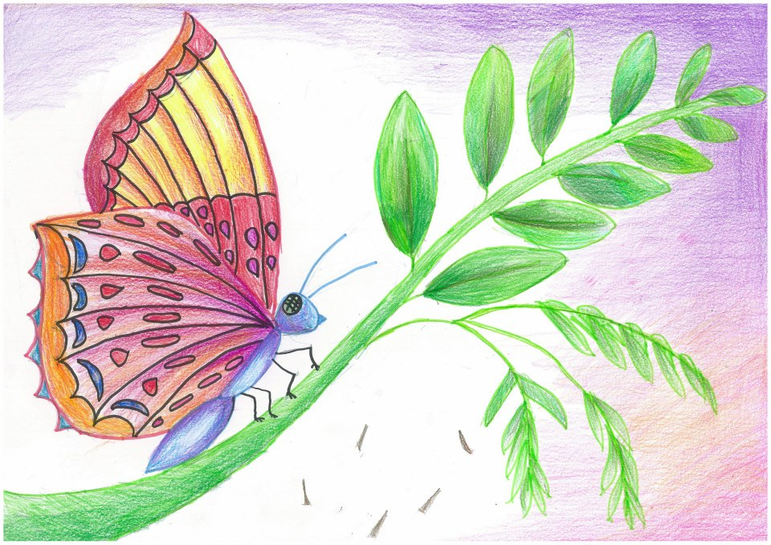

Slide 22
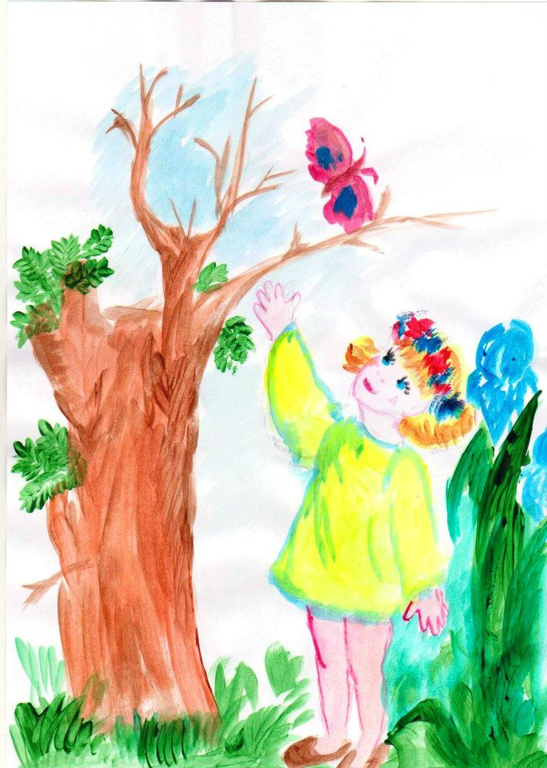
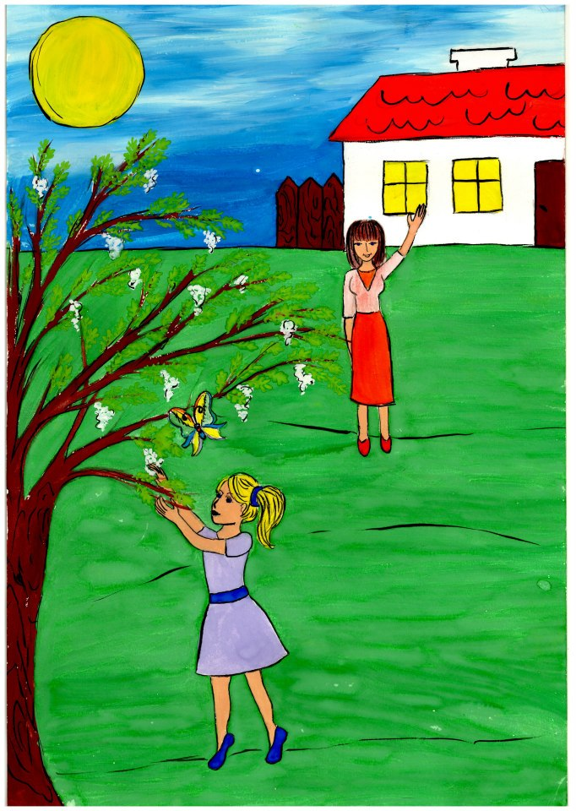

Slide 23
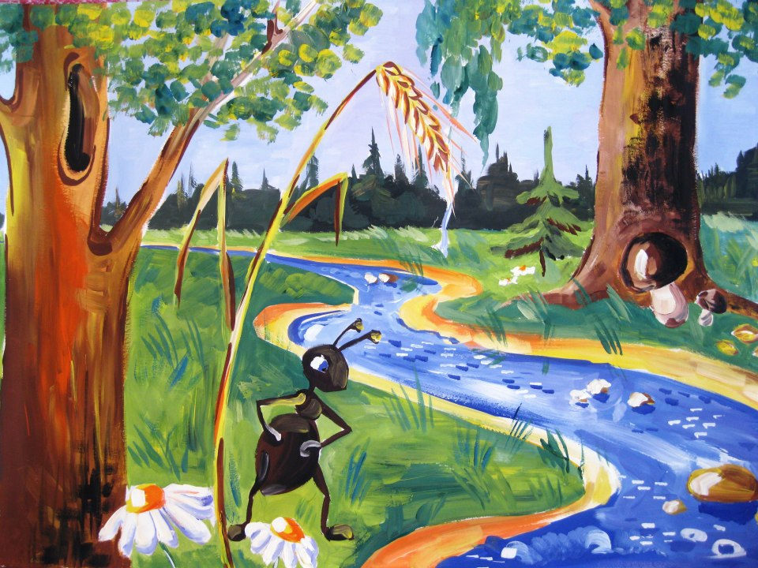
How the Ant Crossed the Stream
In the summertime a little ant was running along a path. He was looking for food as he had little children at home.
Suddenly the path was cut by a trickle of water. On the other side of the water lay some sweet-scented grains. How could he get to them?

Slide 24
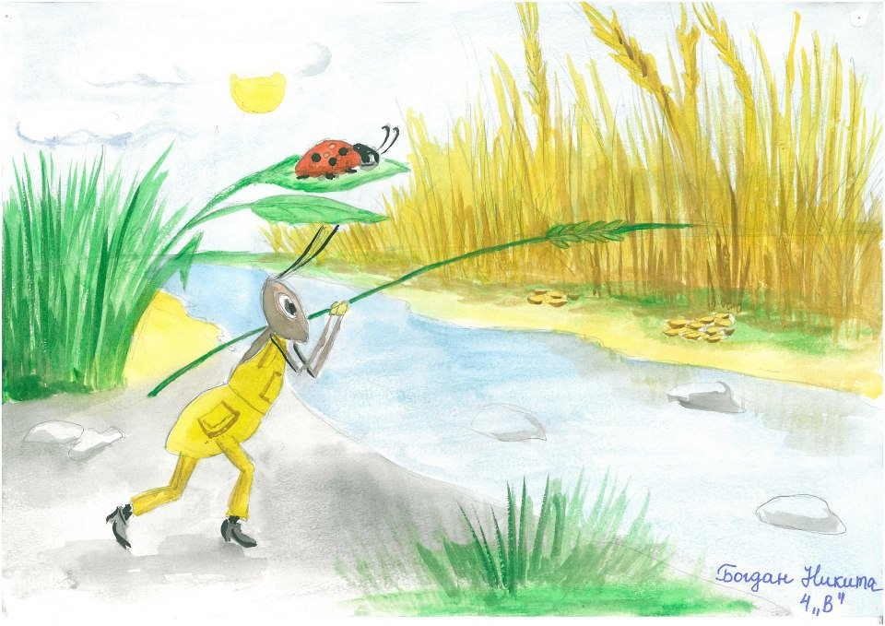
The ant saw a tall blade of rye-grass growing by the water. The ant cut down the blade of grass with his teeth, as sharp as knives. The blade of grass fell across the water.

Slide 25
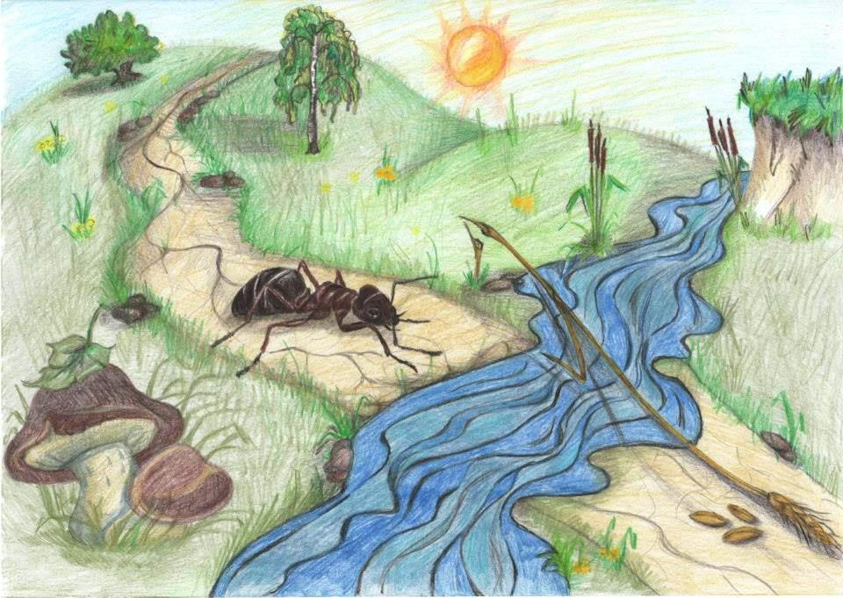
The ant crossed over to the other side, and there were the sweet-scented grains. “I’m coming, children,” he called. “I’m bringing you some food!”

Slide 26
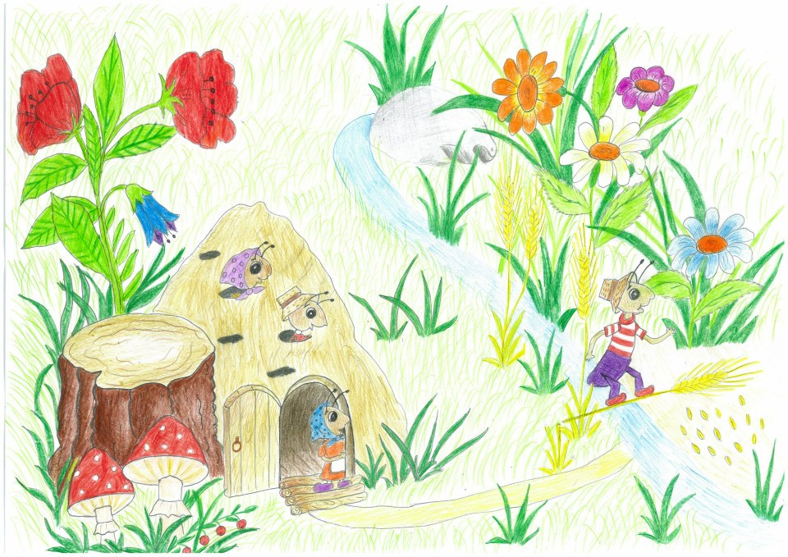

Slide 27
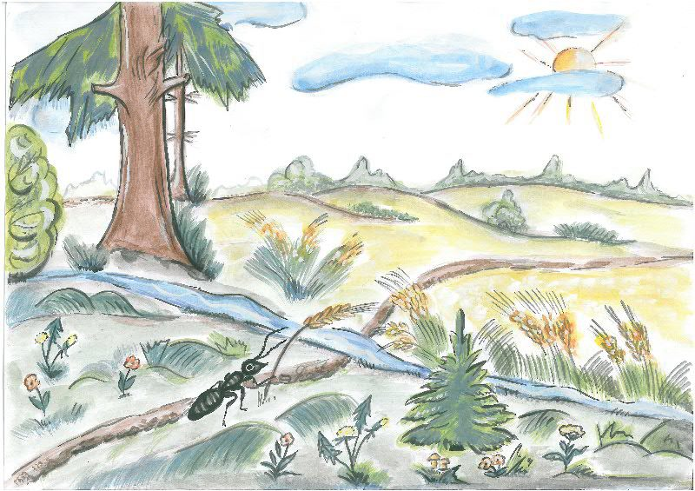

Slide 28
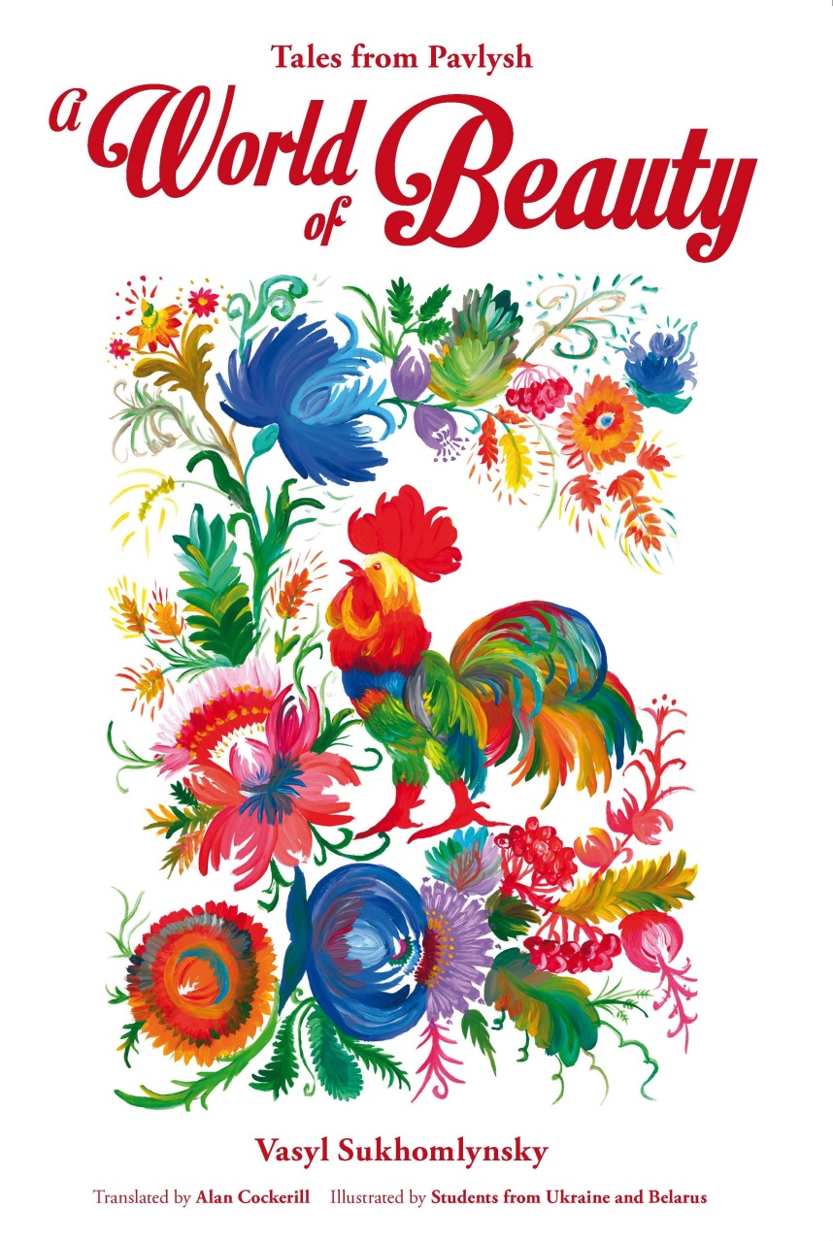
The Picture Book
You can buy the picture book containing 19 stories by Sukhomlynsky, illustrated by students from Ukraine and Belarus, from major online retailers.
EJR Language Service Pty. Ltd.
An Australian company.
Copyright © 2013 EJR Language Service Pty. Ltd. All rights reserved.

