Slide 1
Tales from Pavlysh:
A World of Beauty
Stories by Vasyl Sukhomlinsky
Translation by Alan Cockerill
Presentation 4:
Illustrations by year 10 & 11 students
from Ukraine, Russia and Belarus

Slide 2
The stories and the pictures
The stories in this presentation are all written by Vasyl Sukhomlynsky, a dedicated teacher and school principal who taught at a school in the Ukrainian village of Pavlysh from 1947 to 1970. Most of Sukhomlynsky’s books are written for teachers, but he also wrote many little stories for children. He used these stories to illustrate important values. A selection of 19 stories, all about the beauty of nature, have been published in the picture book Tales from Pavlysh: A World of Beauty.
(The text of these stories is subject to copyright, and may not be used for commercial purposes without the permission of EJR Language Service Pty. Ltd. It is, however, permitted to freely circulate this presentation to schools.)
The pictures in this presentation were entered in a competition to illustrate the 19 stories. Thousands of children, mostly from Ukraine, sent in their entries. Only 23 of the pictures could be used in the book Tales from Pavlysh: A World of Beauty, and it was very difficult to choose them from all the beautiful pictures that were sent in. This presentation, and the other three that go with it, are designed to show Australian children more of the competition entries. It is hoped that Australian children will be inspired to create some beautiful pictures of their own. The illustrations in this fourth presentation are by students in years 10 & 11. Other presentations contain pictures by students in years 3 & 4, 5 & 6, and 7-9.

Slide 3
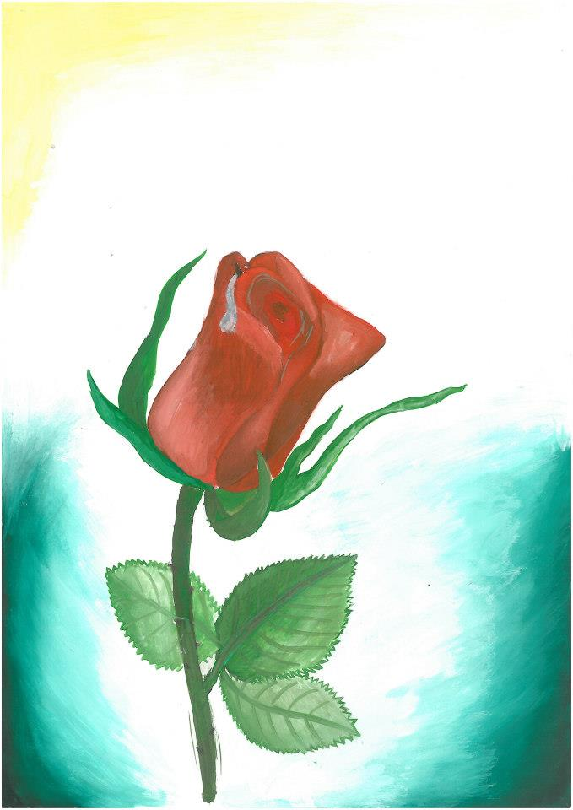
A Drop of Dew
Early one morning, a drop of dew woke up on a rose. “How did I get here?” wondered the dew drop. “Last night I was high in the sky. How did I end up on the earth?”
She wanted to climb back up into the sky.

Slide 4
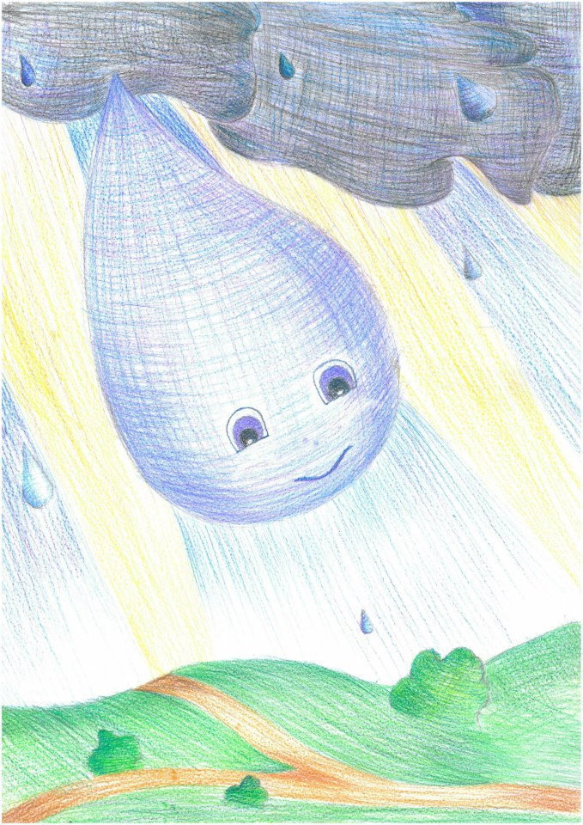
The sun warmed her and she evaporated, rising up and up into the blue sky, right up to the sun. There were thousands of other drops there. They gathered to make a dark cloud and covered the sun.

Slide 5
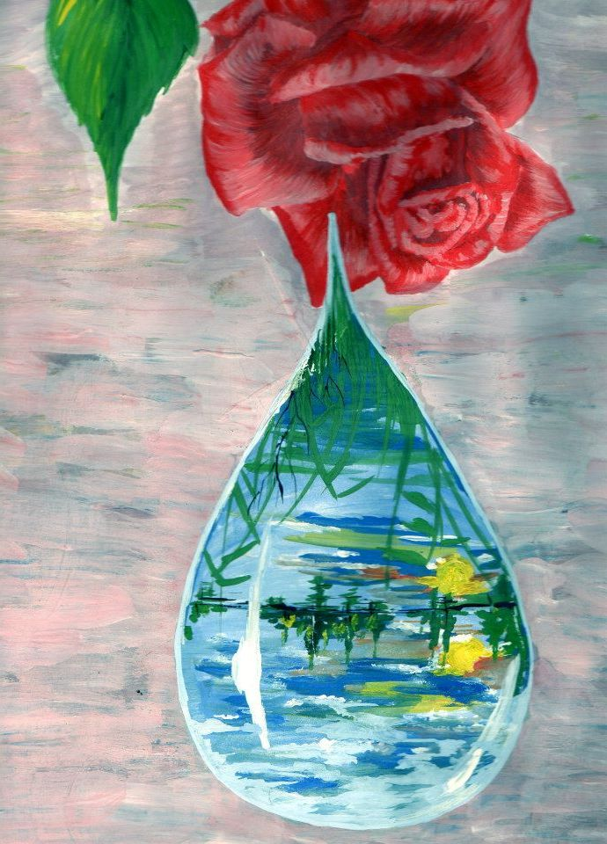
“Why are you hiding me from the people?” The sun was angry, and sent a fiery arrow flying at the cloud. Lightning flashed and thunder rumbled. The dark cloud was frightened and sprinkled water everywhere. It started raining. The drop of water fell back to the earth.
“Thank you for coming back,” said the earth. “I really missed you.”

Slide 6
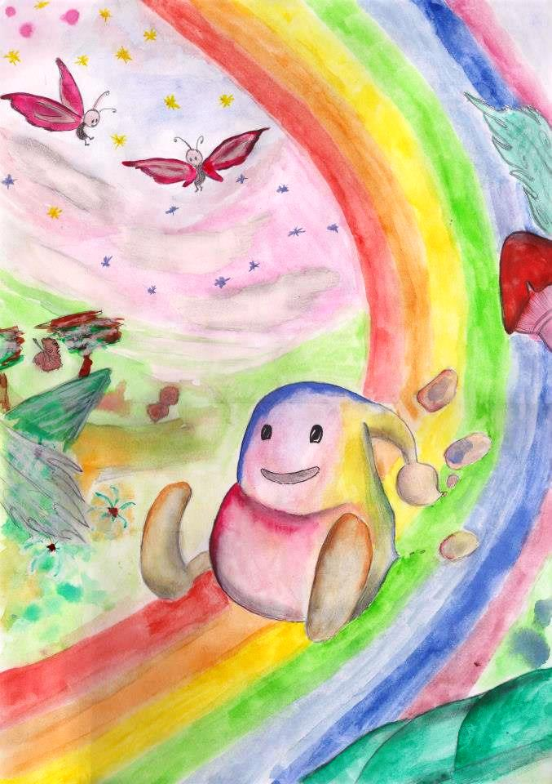
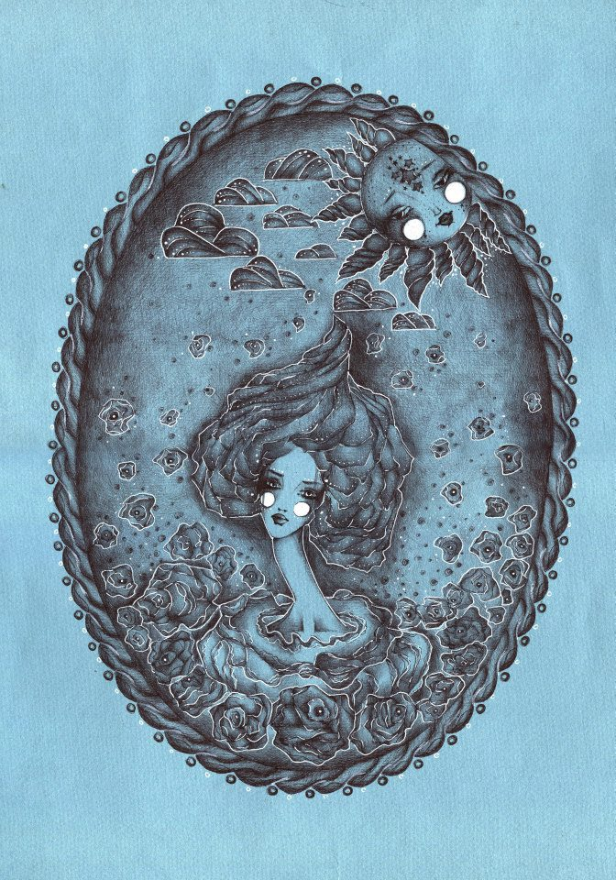

Slide 7
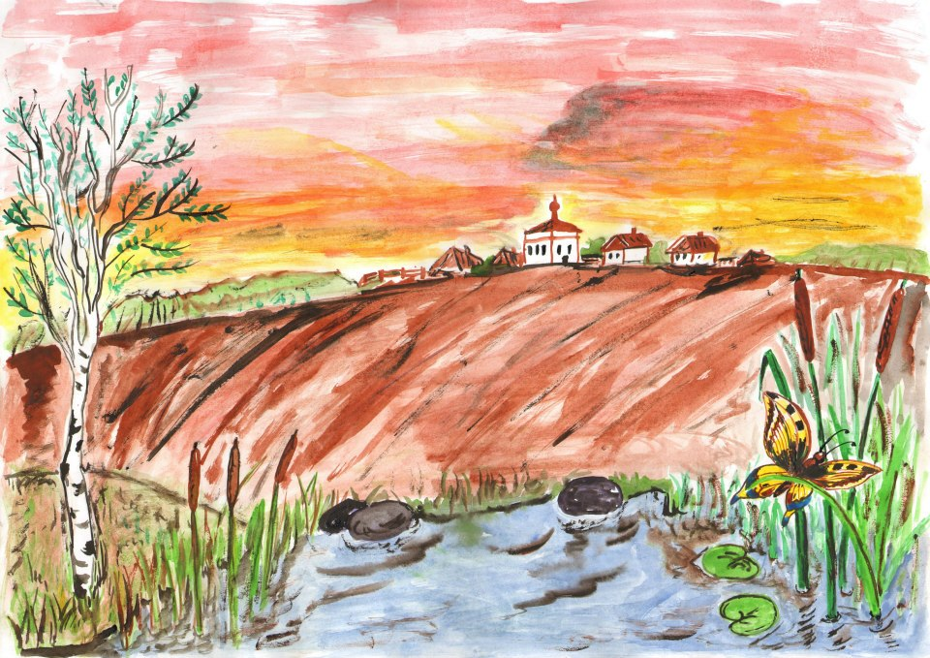
Morning Breeze
It was a quiet summer night. Everything was asleep. Even the breeze was asleep, lying under a willow bush.

Slide 8
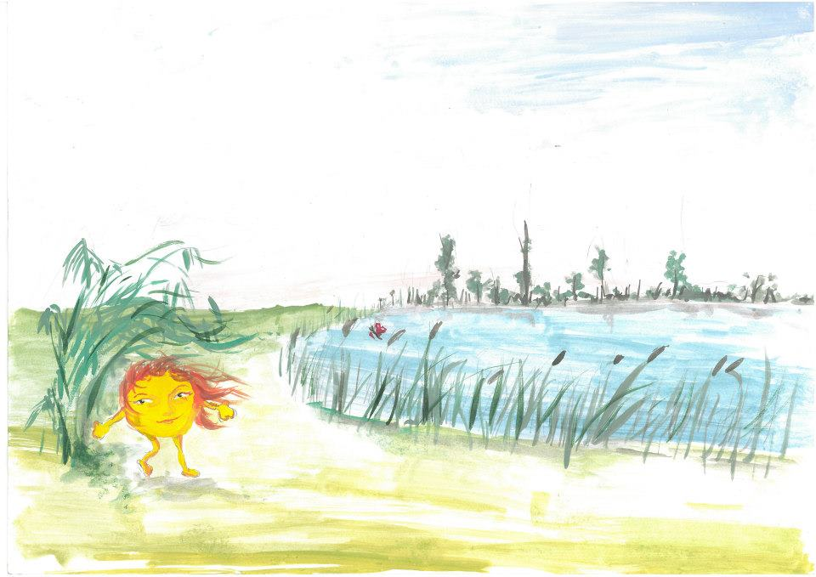
But then the morning dawn began to glow. The breeze woke up, and ran out from under its bush. It ran along the bank of the pond, waking up the reeds. The reeds rustled and swayed.

Slide 9
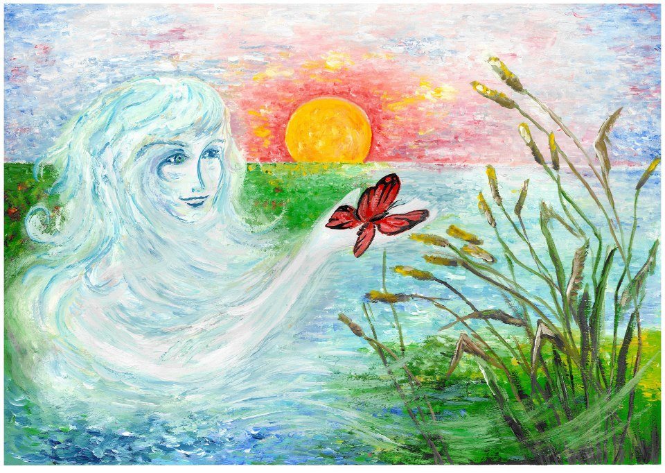
A butterfly was sleeping on the reeds, and it, too, woke up. It flew towards the village, while the dawn blazed ever brighter. Soon the sun would rise.

Slide 10
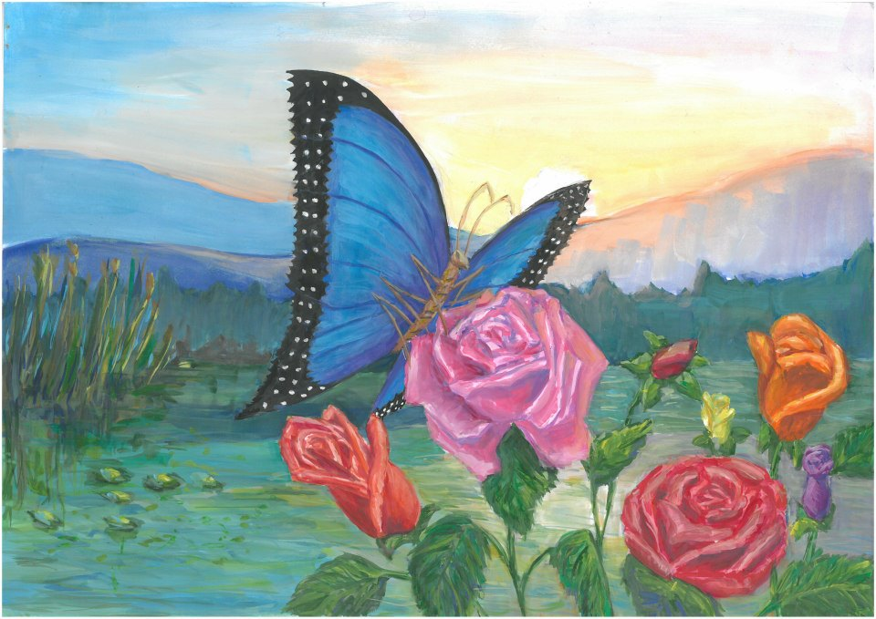
The butterfly fluttered to a rose blossom, and settled on it. The rose woke up and looked around. The sun was already shining.

Slide 11
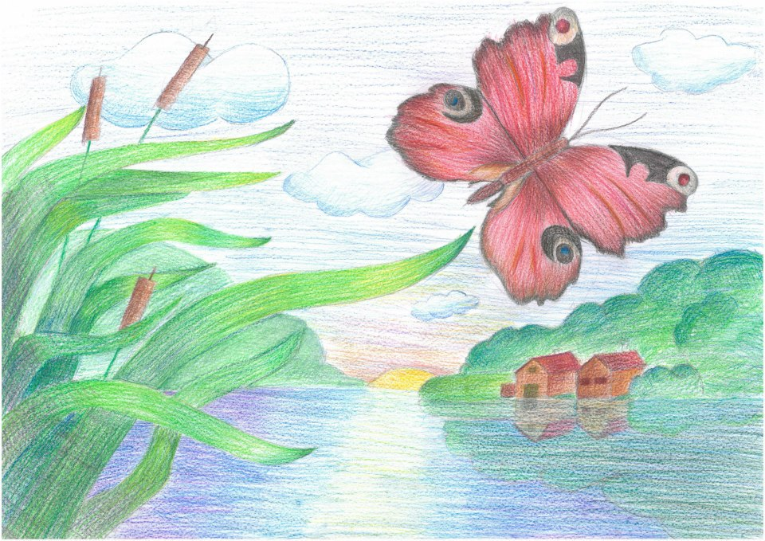

Slide 12
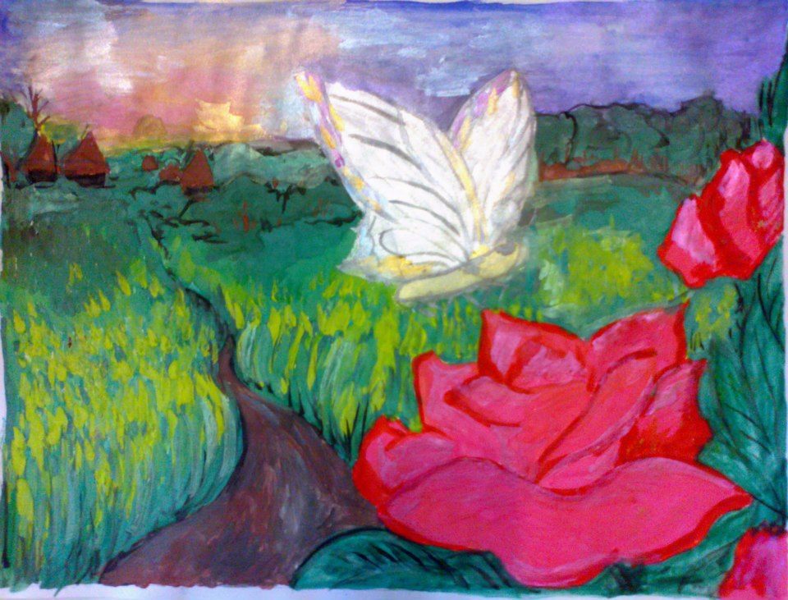

Slide 13
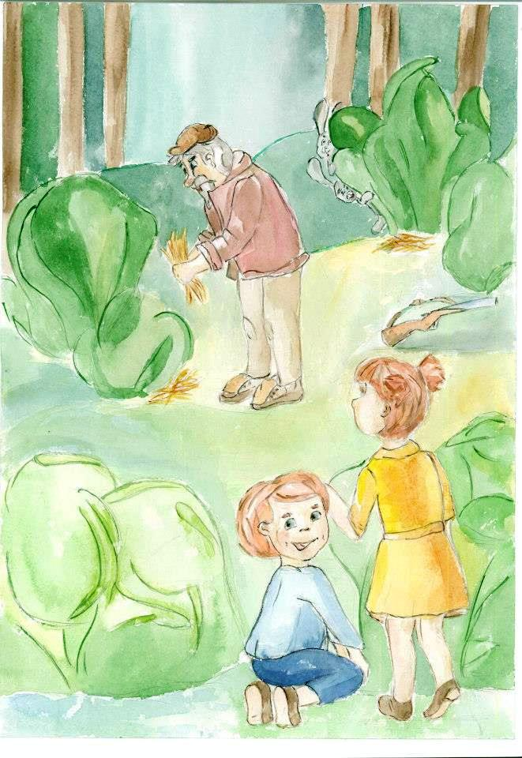
An Unusual Hunter
In our village lives Grandpa Maksim. Everyone says he is a hunter. As soon as the season for hunting hares or ducks begins, Grandpa goes to the forest with his gun. Every day he leaves early in the morning and does not return until evening.

Slide 14
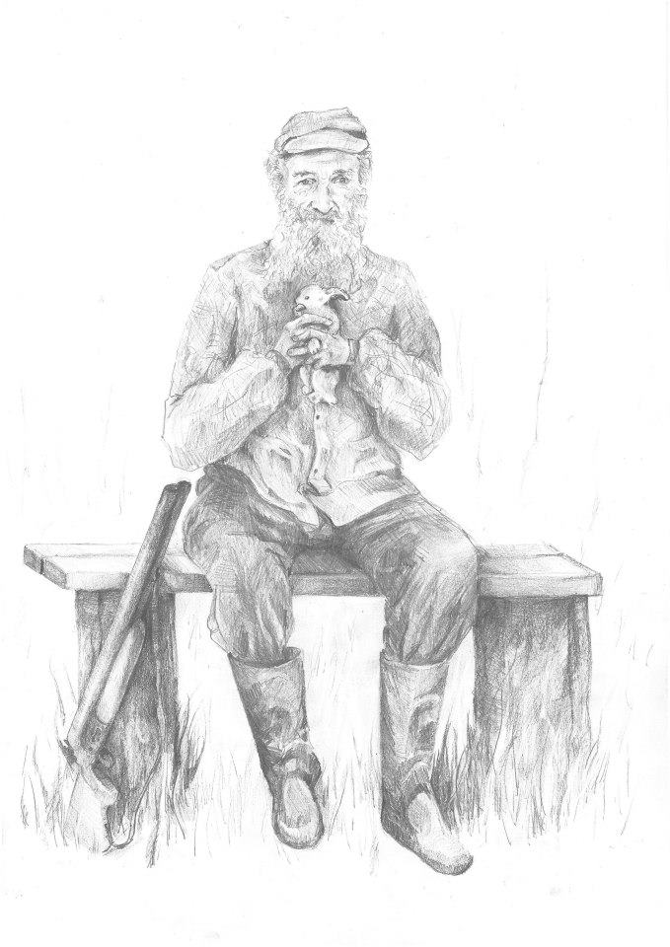
But what an unusual hunter he is! He never brings home a hare or a duck. He comes back with an empty sack. Once he did bring home a little baby hare. He found it under a bush. The hare had a broken leg. Grandpa made a splint from two sticks and bandaged its little leg. After a week the leg mended and Grandpa took the little hare back to the field.

Slide 15
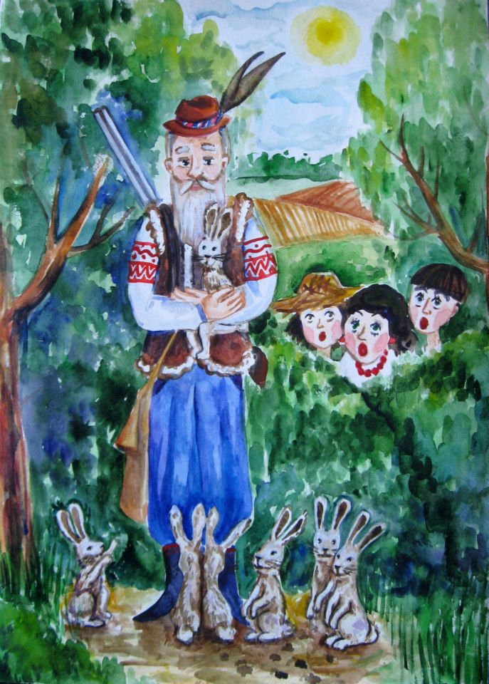
Why is Grandpa Maksim so hopeless at hunting?
One day the children followed Grandpa. They wanted to see how he hunted. They saw him put his gun under a bush, and start walking through the forest laying hay under the bushes for the hares.
Then the children understood why Grandpa Maksim is such an unusual hunter.

Slide 16
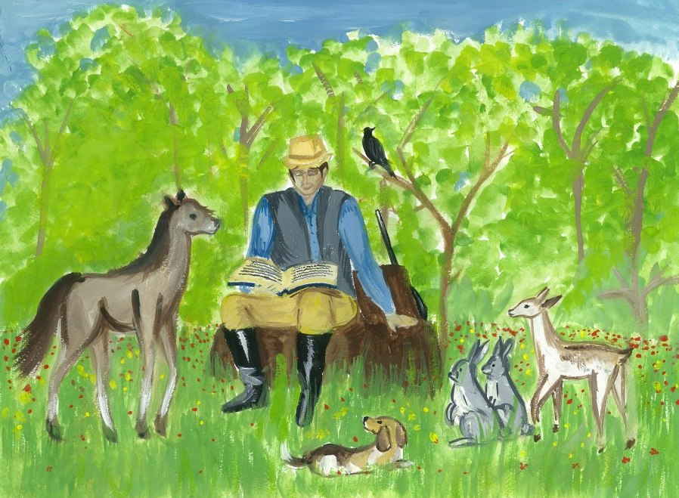

Slide 17
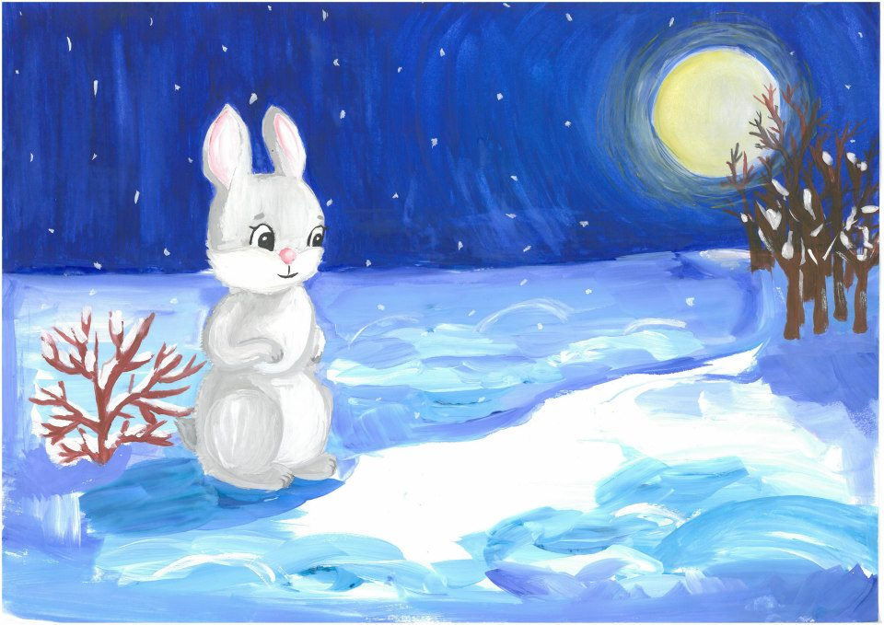
How the Hare Warmed Himself in the Moonlight
The hare was cold in winter, especially at night. He ran to the edge of the forest. The frost was crackling, the snow was shining in the moonlight, and a cold wind blew from the gully.

Slide 18
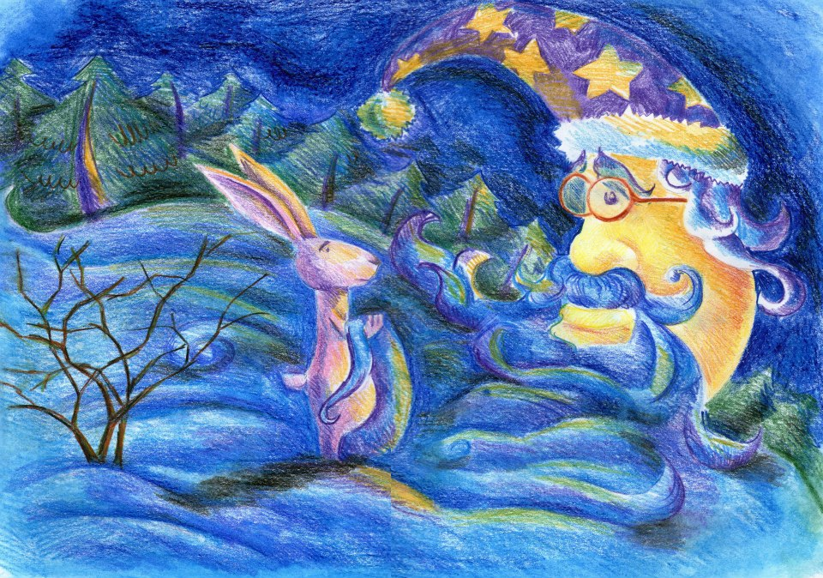
The hare sat under a bush, reached his paws out to the moon and begged: “Dear Moon, please warm me with your rays. It is a long time till sunrise.”

Slide 19
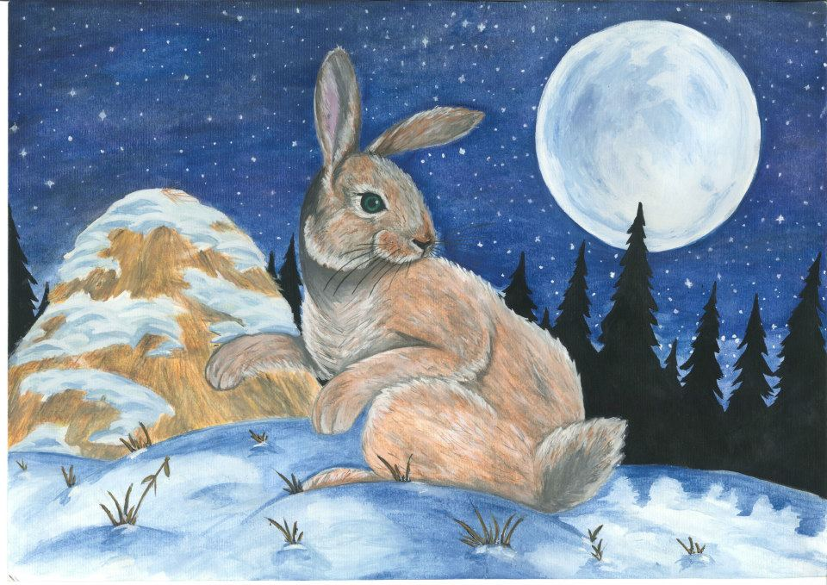
The moon was sorry for the hare, and said to him:
“Keep following the field, and I will light your way. Head straight for that big haystack.”

Slide 20
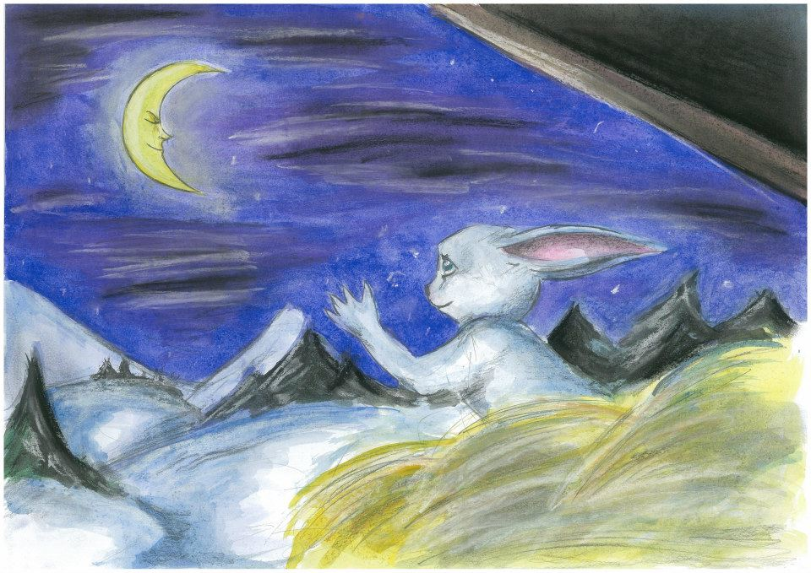
The hare made his way to the haystack, buried himself in the hay, looked out, and smiled at the moon.
“Thank you, kind Moon. Now your rays are warm as can be.”

Slide 21

The Picture Book
You can buy the picture book containing 19 stories by Sukhomlynsky, illustrated by students from Ukraine and Belarus, at our online book store, Holistic Education Books:
http://holistic-education-books.com
$14.95
EJR Language Service Pty. Ltd.
An Australian company.
Copyright © 2013 EJR Language Service Pty. Ltd. All rights reserved.

