Slide 1
Tales from Pavlysh:
A World of Beauty
Stories by Vasyl Sukhomlinsky
Translation by Alan Cockerill
Presentation 3:
Illustrations by year 7, 8 & 9 students
from Ukraine, Russia and Belarus

Slide 2
The stories and the pictures
The stories in this presentation are all written by Vasyl Sukhomlynsky, a dedicated teacher and school principal who taught at a school in the Ukrainian village of Pavlysh from 1947 to 1970. Most of Sukhomlynsky’s books are written for teachers, but he also wrote many little stories for children. He used these stories to illustrate important values. A selection of 19 stories, all about the beauty of nature, have been published in the picture book Tales from Pavlysh: A World of Beauty.
(The text of these stories is subject to copyright, and may not be used for commercial purposes without the permission of EJR Language Service Pty. Ltd. It is, however, permitted to freely circulate this presentation to schools.)
The pictures in this presentation were entered in a competition to illustrate the 19 stories. Thousands of children, mostly from Ukraine, sent in their entries. Only 23 of the pictures could be used in the book Tales from Pavlysh: A World of Beauty, and it was very difficult to choose them from all the beautiful pictures that were sent in. This presentation, and the other three that go with it, are designed to show Australian children more of the competition entries. It is hoped that Australian children will be inspired to create some beautiful pictures of their own. The illustrations in this third presentation are by students in years 7, 8 & 9. Other presentations contain pictures by students in years 3 & 4, 5 & 6, and 10 & 11.

Slide 3
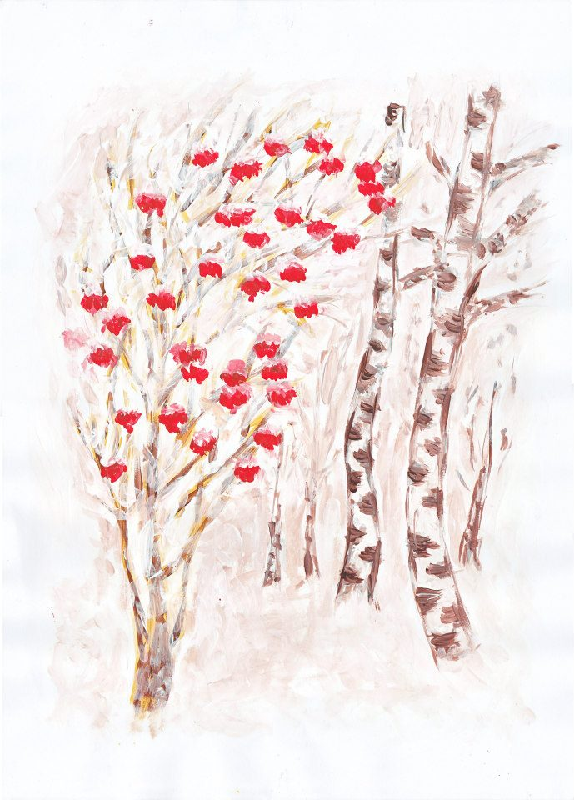
Who the Rowan Tree was waiting for
The rowan tree shed its leaves. Only bunches of red berries remained. They hung like beads, beautiful, but bitter and tart. Whenever birds came and tried the berries, they found them bitter and flew on.

Slide 4
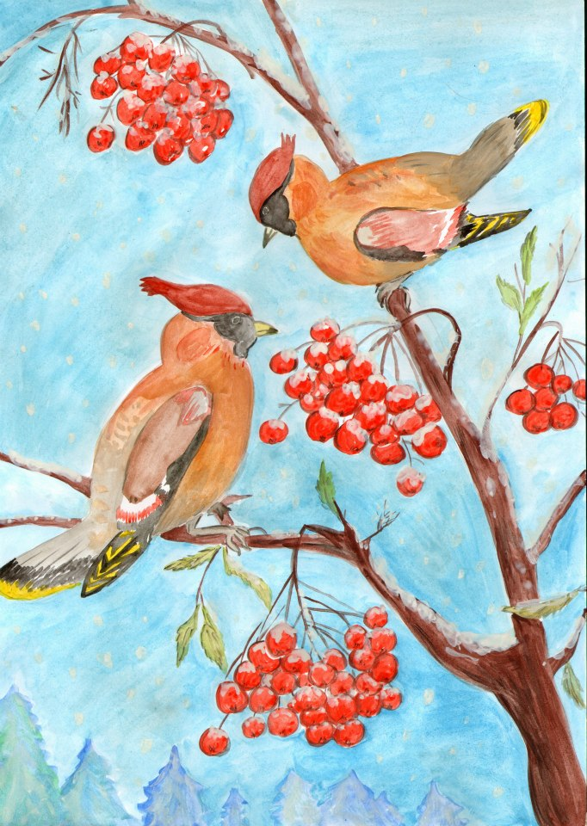
Then one morning a beautiful song rang out above the rowan tree, as if silver strings were being played. Some wonderful crested birds had arrived. They were waxwings. They had flown from the far north. They were the ones the rowan tree had been waiting for! Joyfully she welcomed her guests with her red berries. None of the other birds knew the rowan tree’s berries had become sweet.

Slide 5
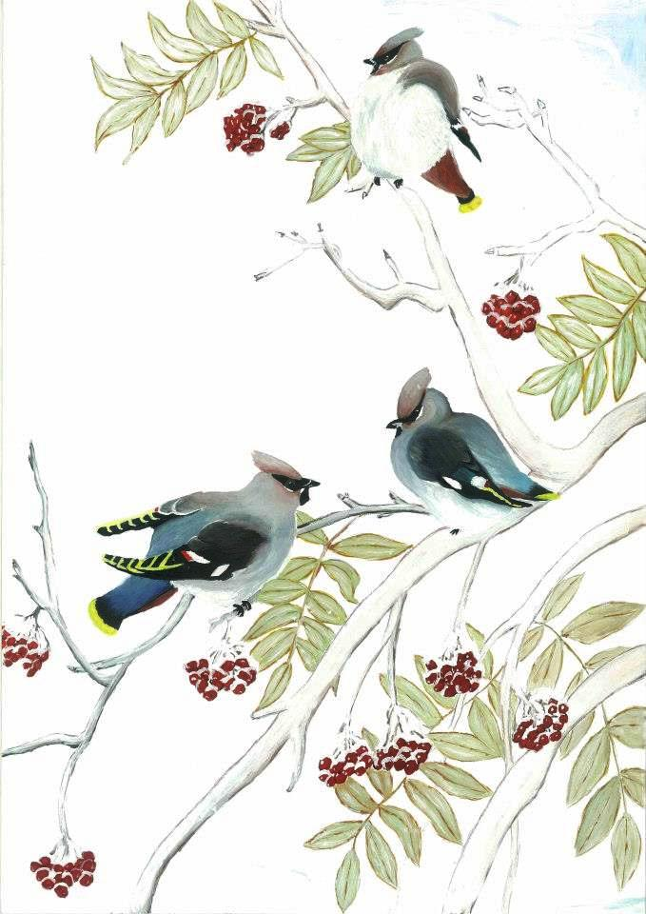
People say frost makes the berries sweet, but it was not the frost. It was grief. The rowan tree had waited so long for its dear guests, feeling sad, grieving, worrying that they would not come. And its grief made the berries sweet.

Slide 6
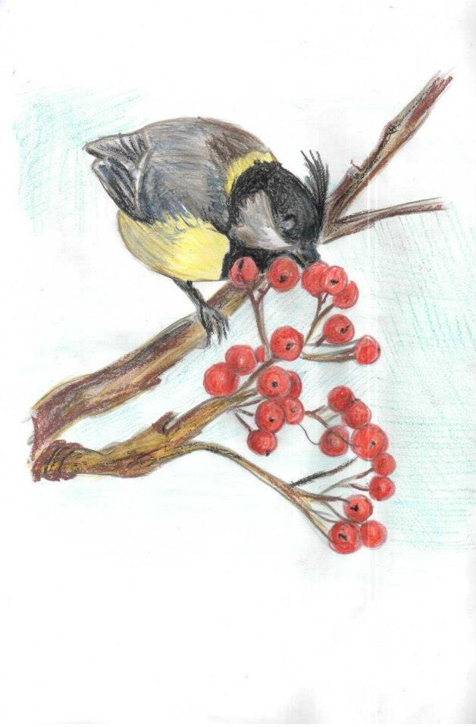
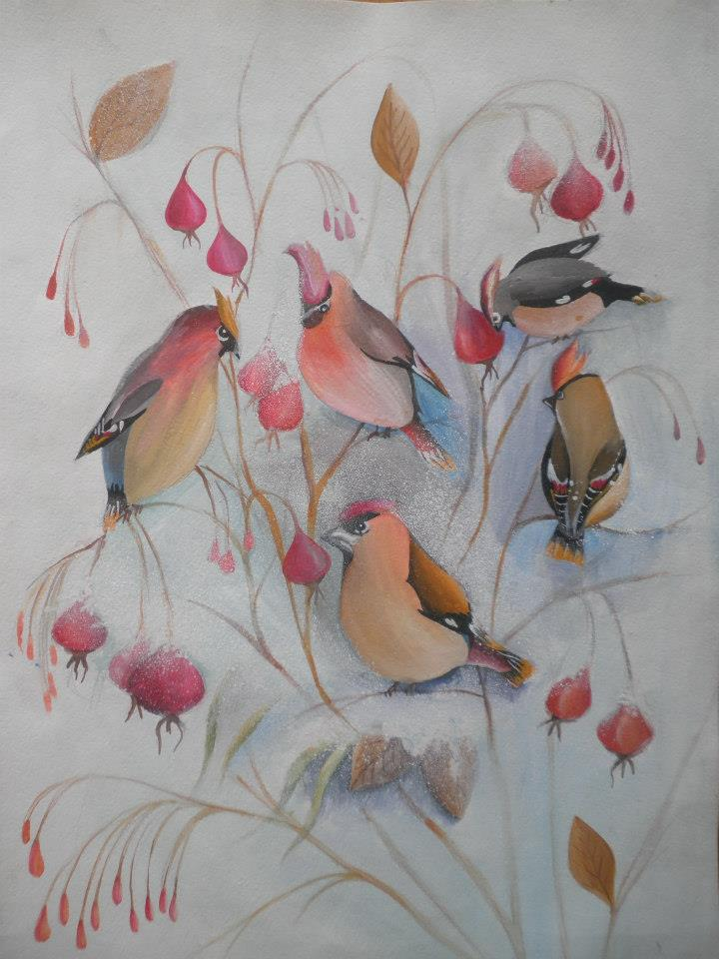

Slide 7
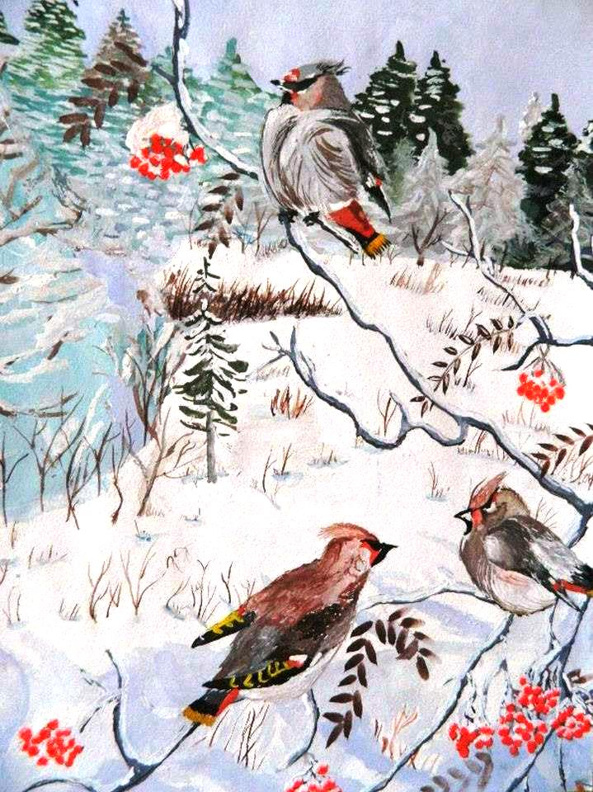
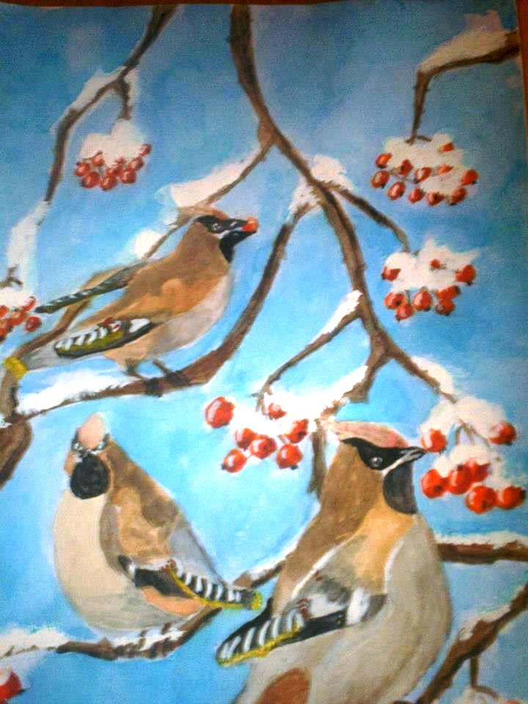

Slide 8
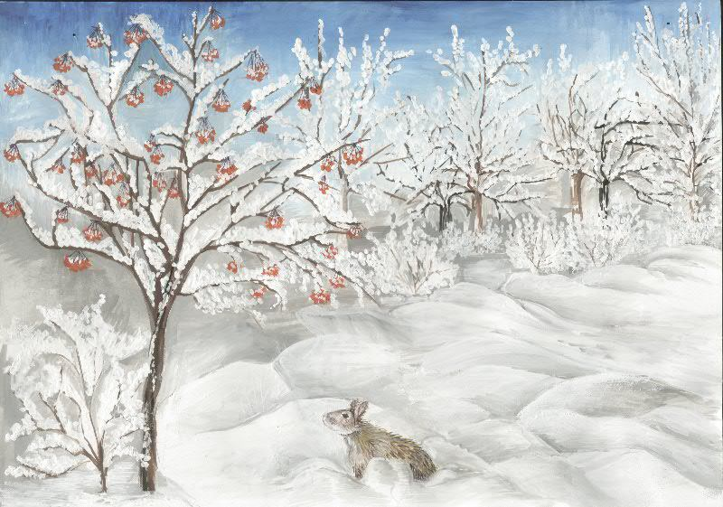
The Hare and the Rowan Tree
Winter sets in. The earth is covered in snow. It is hard for Hare to find food.
One day he sees some red berries on a rowan tree. Hare jumps all around the tree, but the berries are too high.

Slide 9
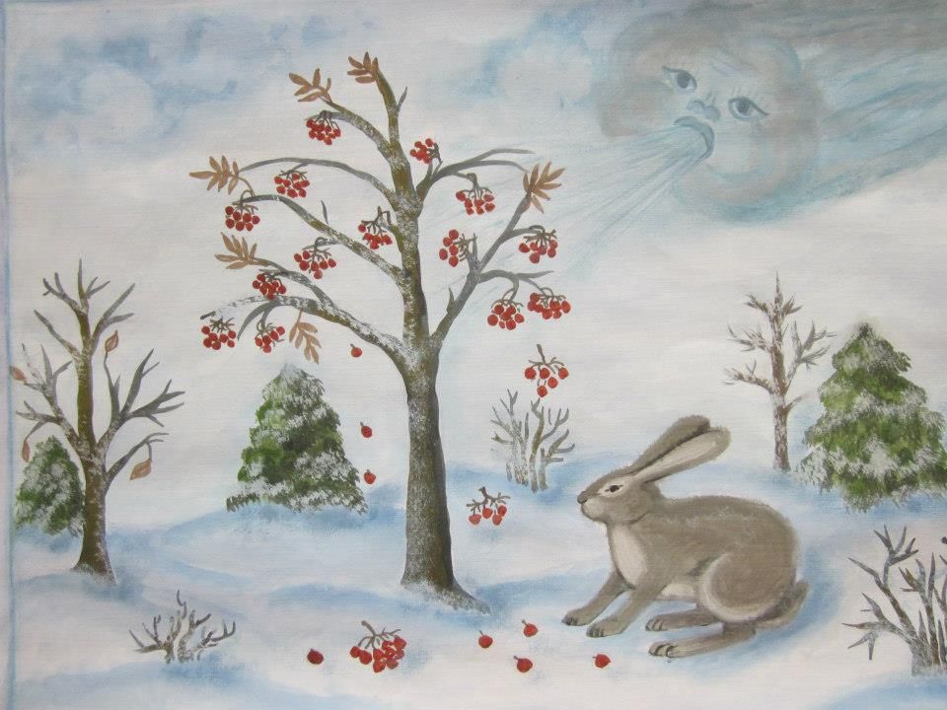
Hare begs: “Dear Rowan tree, please give me some berries.”
And the rowan tree answers: “Ask Wind. It will help you.”
Hare asks Wind. Wind blows. It rocks and shakes the rowan tree. A bunch of red berries breaks off and falls in the snow.

Slide 10
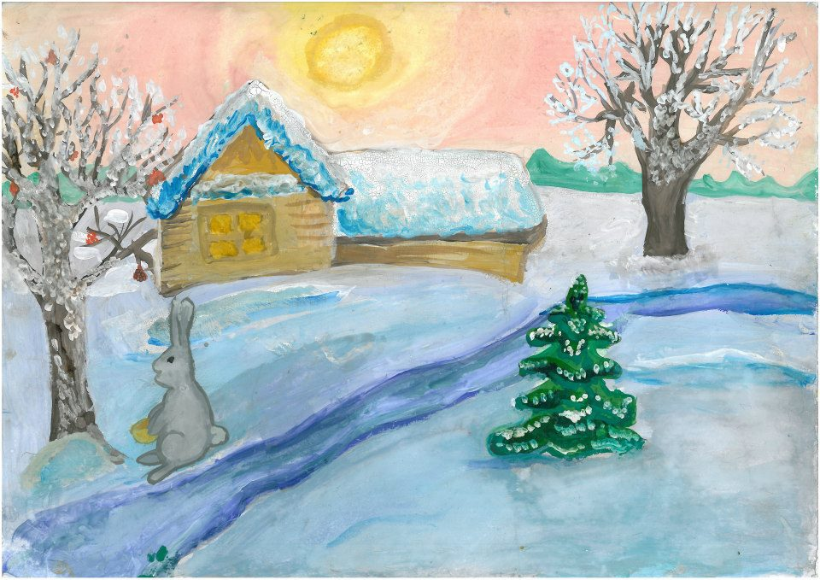
Hare rejoices in the berries.
“Thank you, Wind,” he says.

Slide 11
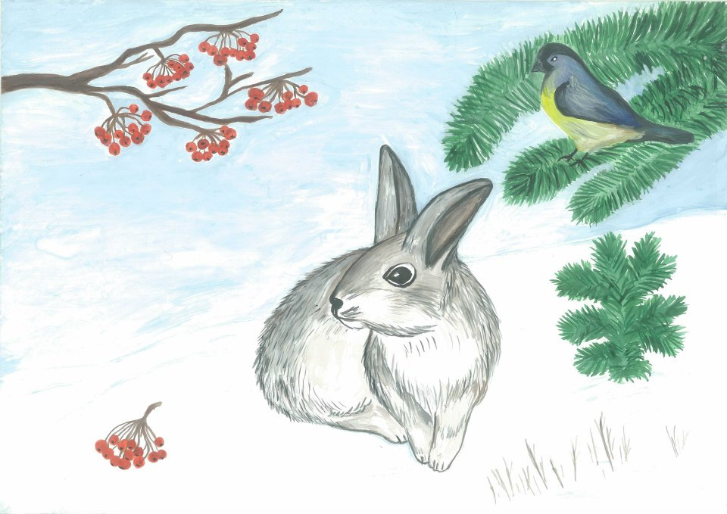

Slide 12
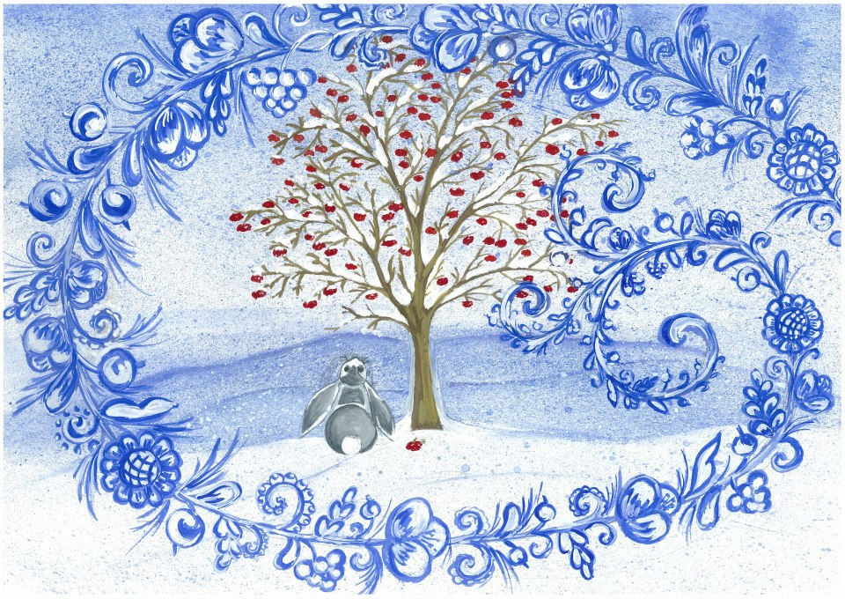

Slide 13
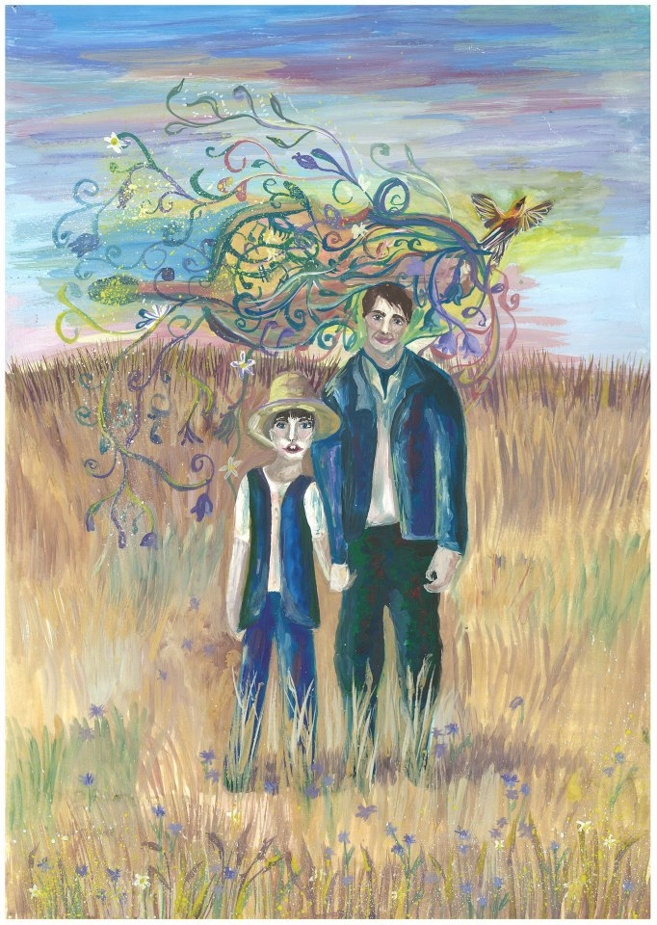
Those Poor People…
It is still dark; the dawn has not arrived. But Seryozha’s father wakes him and says:
“Let’s go out to the field. We’ll listen to the song of the lark.”
Seryozha gets up quickly and dresses and they walk to the field.

Slide 14
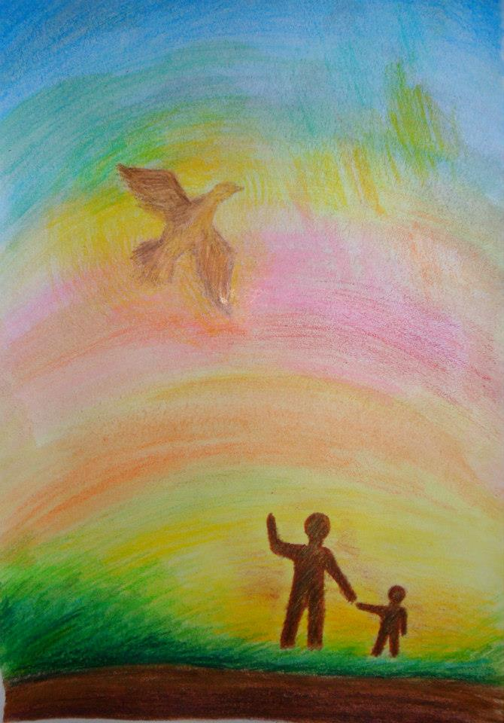
The sky in the east is becoming pale, turning blue and then pink, and the stars are going out. From some distant meadow a little grey ball climbs up and flies high in the sky. Suddenly the grey ball lights up like fire in the azure sky and the father and son hear enchanting music. It is as if someone has stretched a silver string over the field, and the fiery little bird is touching the string with its wings, sprinkling the field with magic sounds.

Slide 15
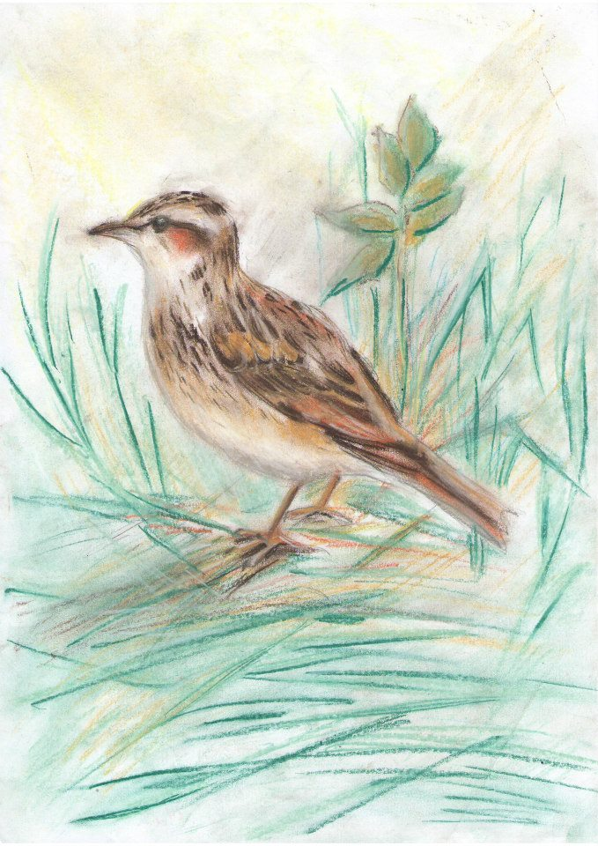
Seryozha holds his breath. “If we were sleeping, would the lark still have sung?” he wonders.
“Dad,” whispers the boy quietly, “the ones who are still sleeping—can they hear this music?”
“They can’t hear it,” whispers Dad.
“Those poor people…”

Slide 16
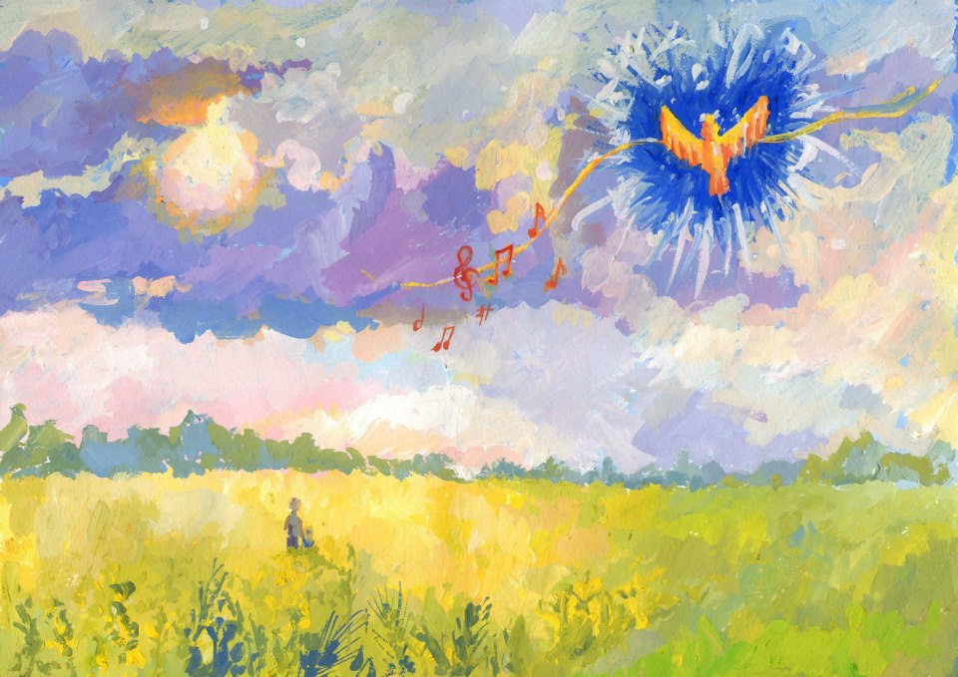

Slide 17
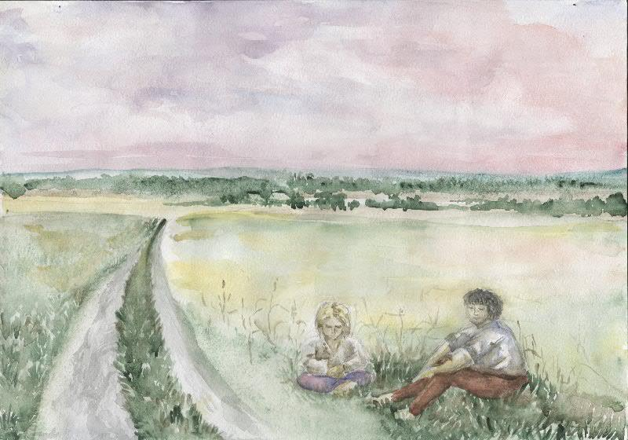

Slide 18
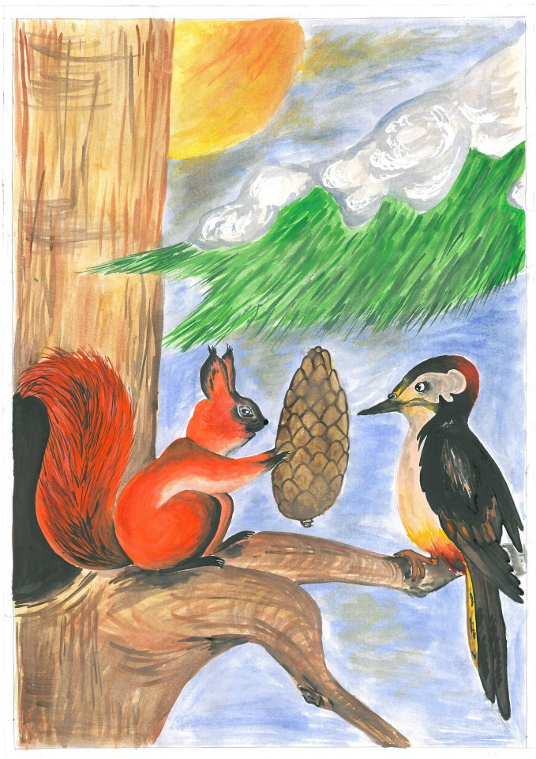
How the Squirrel Saved the Woodpecker
In the middle of winter it turned warm, and rain fell, and then the frost struck again. The trees were covered in ice. Even the cones on the fir trees were frozen. There was nothing for the woodpecker to eat. No matter how much he pecked at the ice, he could not get to the bark. No matter how hard he beat the cones with his beak, no seeds came out of them.

Slide 19
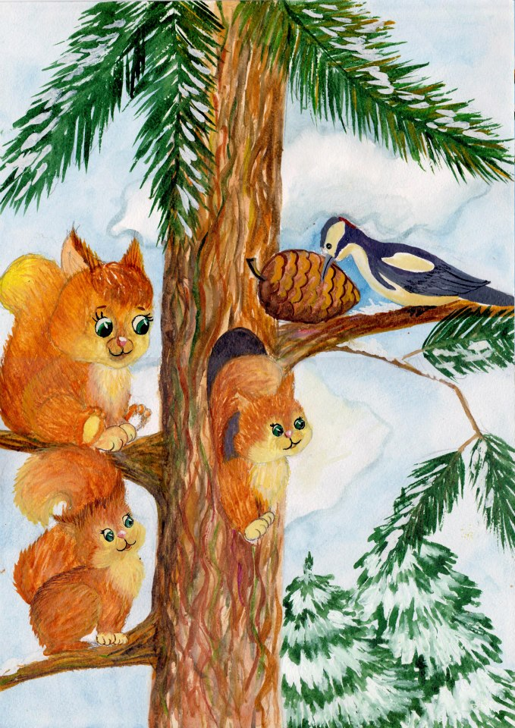
The woodpecker sat on the fir tree and cried. His warm tears fell on the snow and froze.
From her nest the squirrel saw the woodpecker crying. With a hop and a jump she came running to the woodpecker.
“Woodpecker, why are you crying?”
“There’s nothing to eat, Squirrel…”

Slide 20
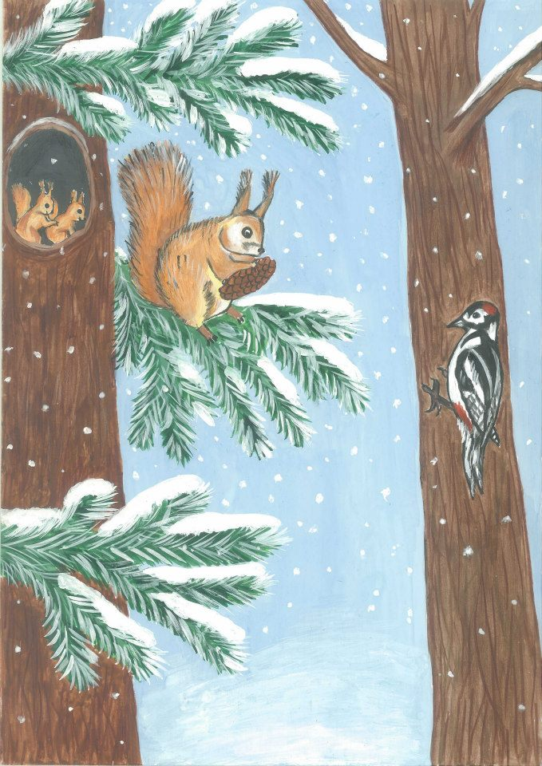
The squirrel felt sorry for the woodpecker. From out of her nest in the tree she carried a large fir cone. She put it between the trunk and a branch. The woodpecker landed next to the cone and began to hammer it with his beak.
And the squirrel sat by her nest and rejoiced. Her baby squirrels in the nest rejoiced, too. Even the sun rejoiced.

Slide 21
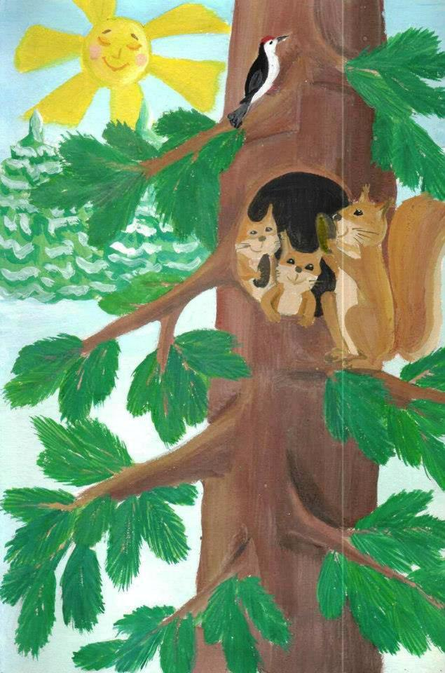
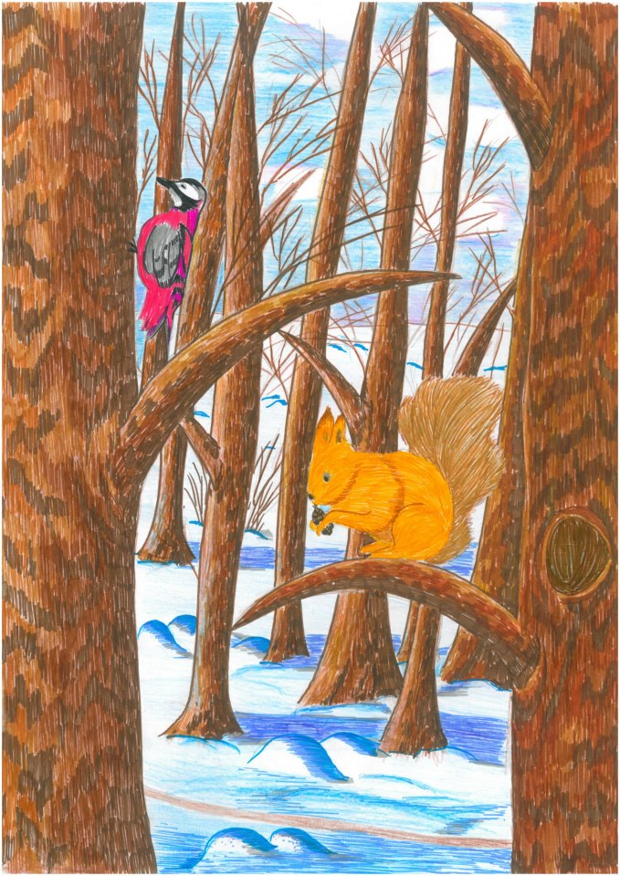

Slide 22
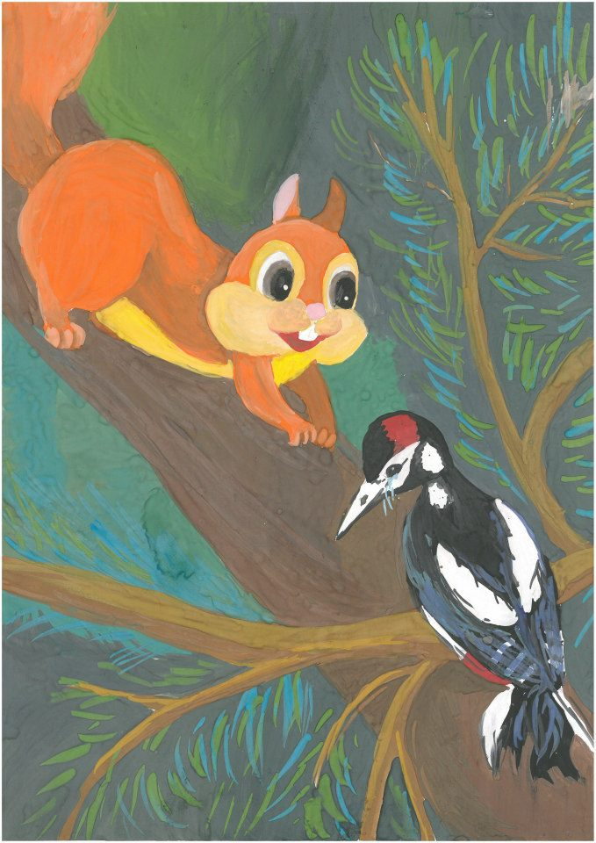
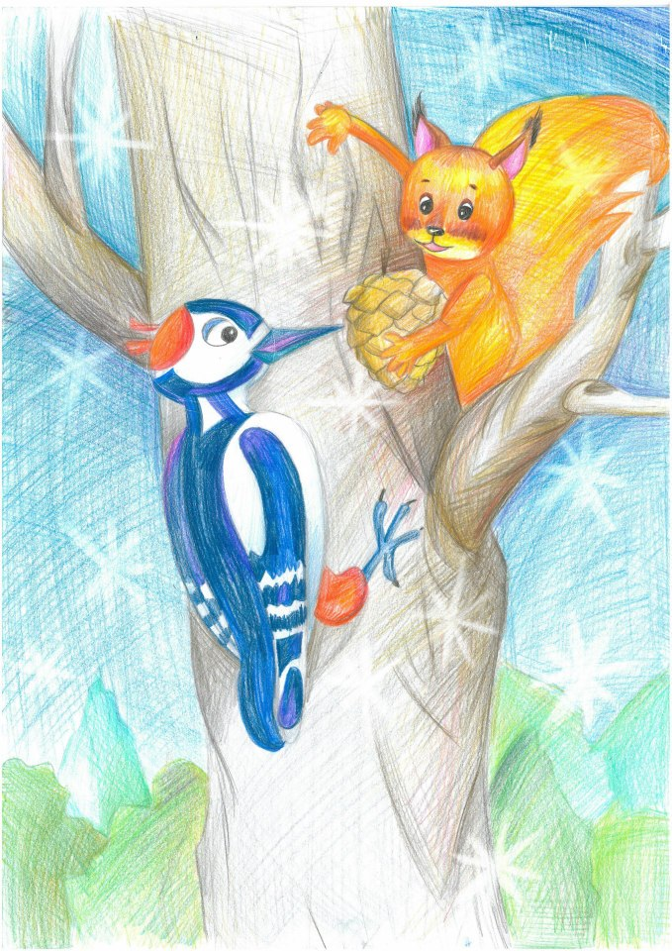

Slide 23
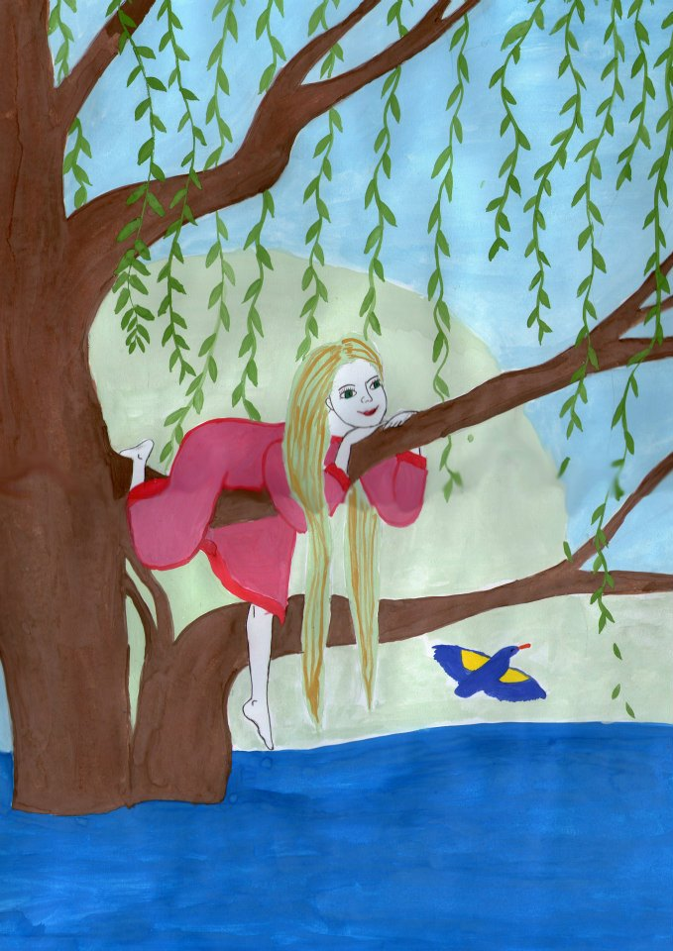
They Cut Down the Willow
The willow grew by a pond. On quiet summer mornings she looked into the water. Her leaves neither moved nor whispered. But when birds landed on the willow, her leaves trembled. That was because she was surprised. “What bird has landed on me?” she thought.

Slide 24
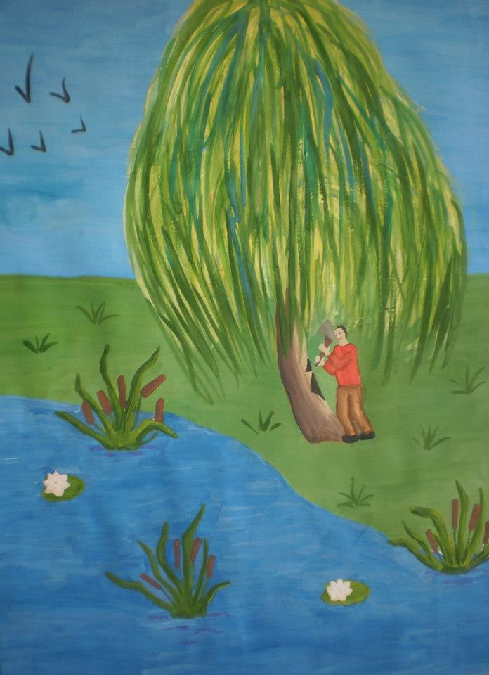
One day a man came to the pond with an axe. He went up to the willow, took aim and struck. Wood chips flew. The willow shook and even groaned, and her leaves anxiously asked each other: “What is that man doing?”

Slide 25
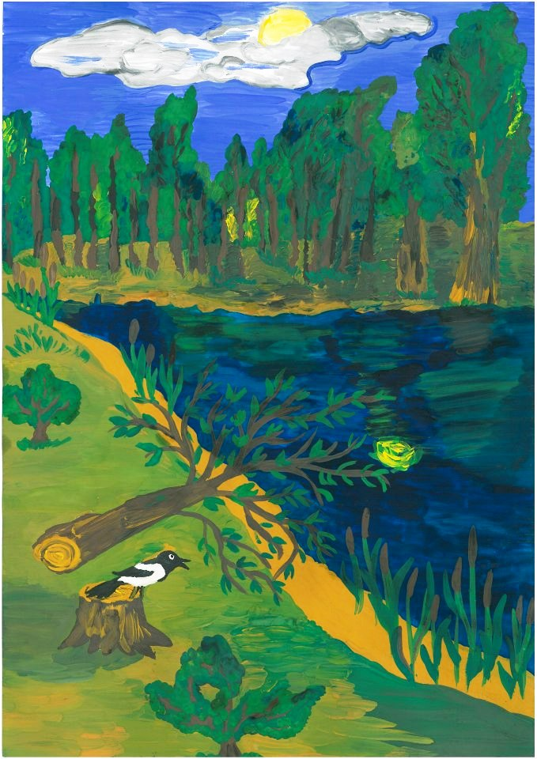
The hewn willow fell. The pond fell silent. The reeds were still. A bird called anxiously. A grey cloud covered the sun and everything around became sad.

Slide 26
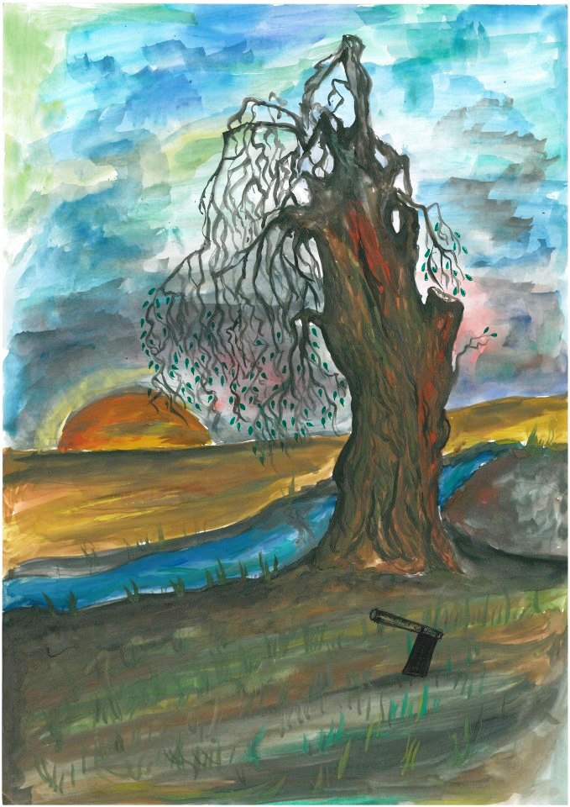
The hewn willow lay stretched out, and the leaves whispered to each other and asked: “Why are we lying on the ground?”
Where the axe had cut through it, the willow began to weep. Pure, transparent tears fell on the earth.

Slide 27
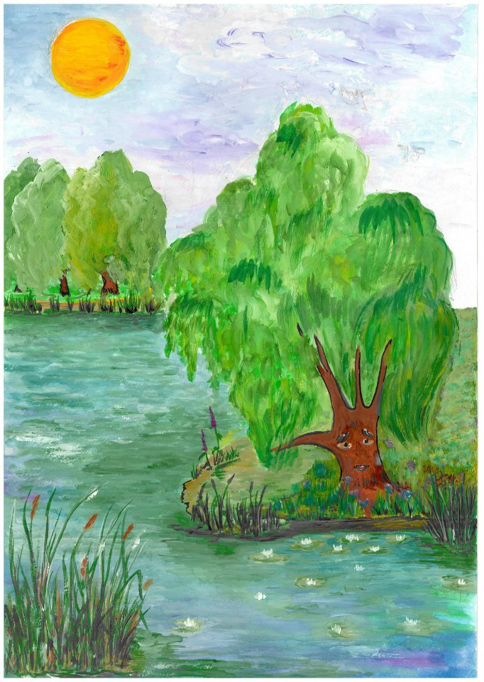
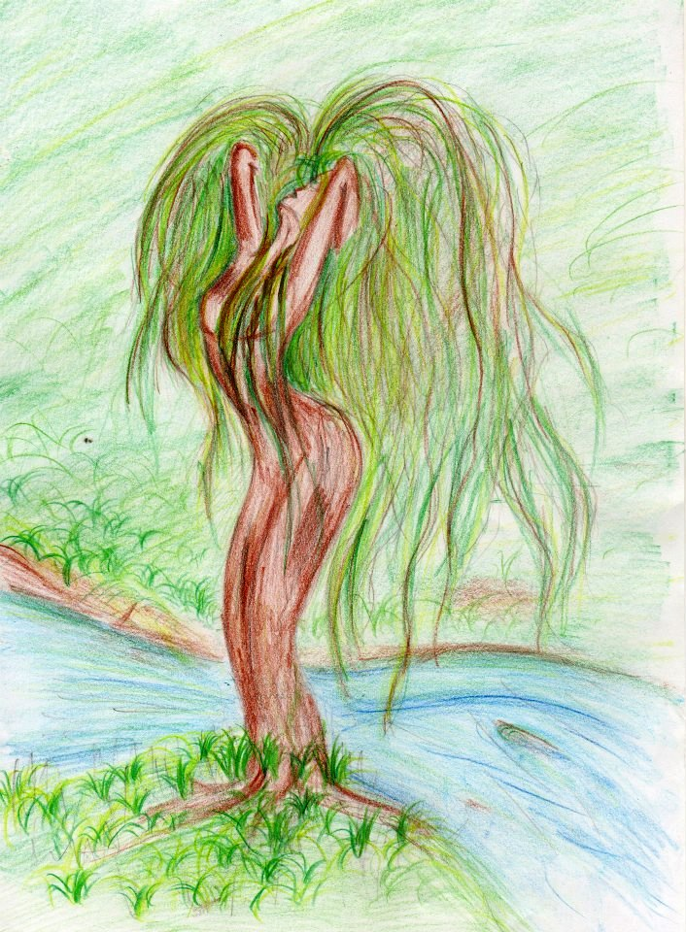

Slide 28
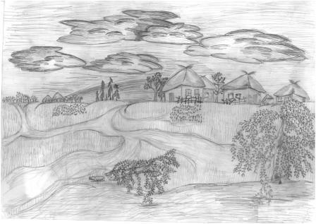

Slide 29

The Picture Book
You can buy the picture book containing 19 stories by Sukhomlynsky, illustrated by students from Ukraine and Belarus, at our online book store, Holistic Education Books:
http://holistic-education-books.com
$14.95
EJR Language Service Pty. Ltd.
An Australian company.
Copyright © 2013 EJR Language Service Pty. Ltd. All rights reserved.

