Slide 1
Tales from Pavlysh:
A World of Beauty
Stories by Vasyl Sukhomlinsky
Translation by Alan Cockerill
Presentation 2:
Illustrations by year 5 & 6 students
from Ukraine, Russia and Belarus

Slide 2
The stories and the pictures
The stories in this presentation are all written by Vasyl Sukhomlynsky, a dedicated teacher and school principal who taught at a school in the Ukrainian village of Pavlysh from 1947 to 1970. Most of Sukhomlynsky’s books are written for teachers, but he also wrote many little stories for children. He used these stories to illustrate important values. A selection of 19 stories, all about the beauty of nature, have been published in the picture book Tales from Pavlysh: A World of Beauty.
(The text of these stories is subject to copyright, and may not be used for commercial purposes without the permission of EJR Language Service Pty. Ltd. It is, however, permitted to freely circulate this presentation to schools.)
The pictures in this presentation were entered in a competition to illustrate the 19 stories. Thousands of children, mostly from Ukraine, sent in their entries. Only 23 of the pictures could be used in the book Tales from Pavlysh: A World of Beauty, and it was very difficult to choose them from all the beautiful pictures that were sent in. This presentation, and the other three that go with it, are designed to show Australian children more of the competition entries. It is hoped that Australian children will be inspired to create some beautiful pictures of their own. The illustrations in this second presentation are by students in years 5 & 6. Other presentations contain pictures by students in years 3 & 4, 7-9, and 10 & 11.

Slide 3
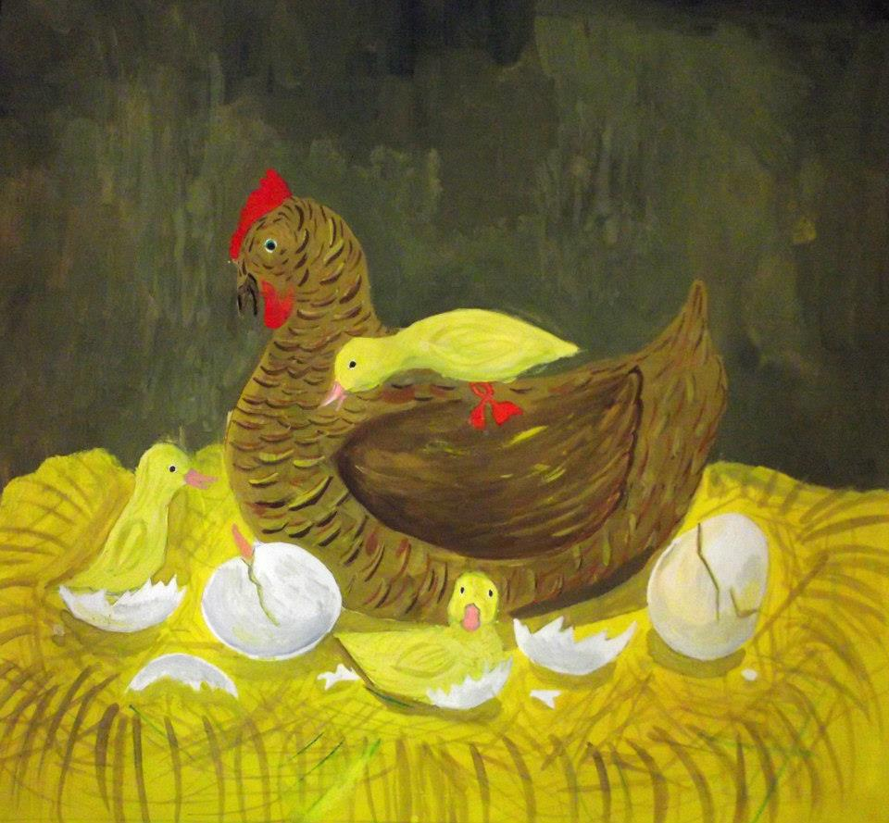
What is Wrong with my Children?
A broody hen was given ten duck eggs. She sat on them for a long time, dreaming of her babies. Ten little yellow birds hatched, and straight away wanted to go for a walk. The hen took them out into the yard. She led them to a pile of dung and began to scratch at the ground. She called her chicks, but they saw something more interesting. They saw a pond. They ran to it, jumped in the water and started paddling.

Slide 4
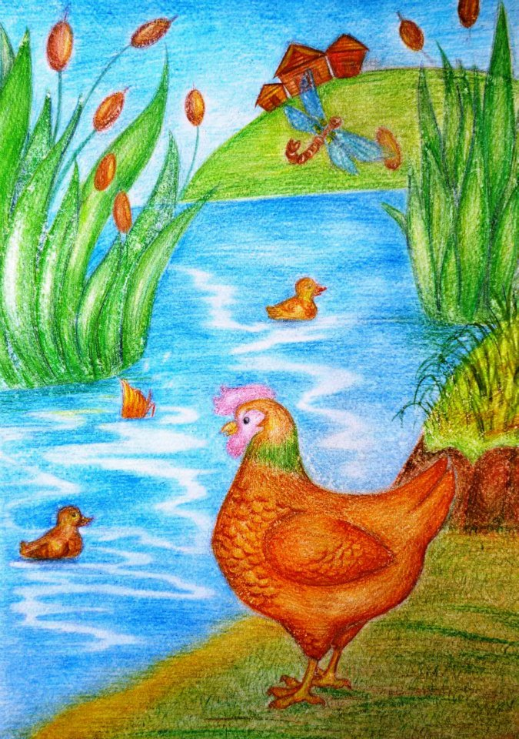
The hen clucked in alarm as she watched her paddling chicks. “Come back!” she called. “You’ll drown!”
But the little birds did not seem to hear. After all, they weren’t chicks. They were ducklings. They paddled for a long time and did not get out of the water till evening. The hen patiently waited for them. She waited and waited, and then took them home.

Slide 5
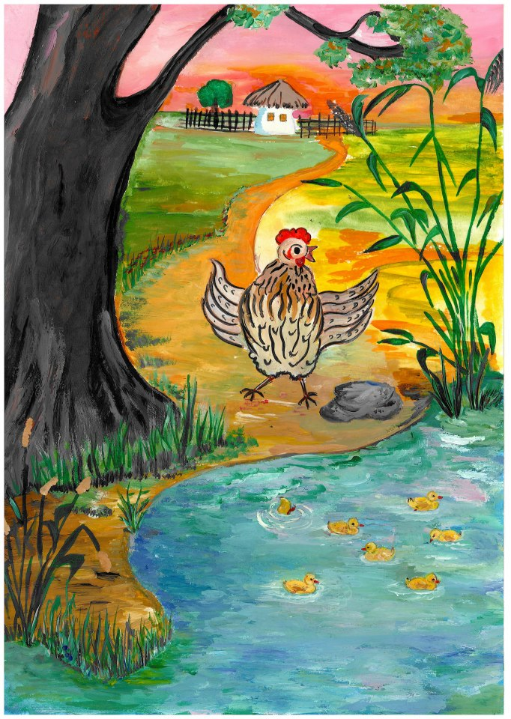
She waddled in front of them and complained: “You don’t listen to me. And who taught you to swim? Your mother can’t swim. Your father can’t swim. Why are you swimming? I won’t let you near the pond again.”
But the ducklings cheeped back: “Mum, tomorrow you can swim with us. It’s so nice in the water!”
The hen looked at her little ones and wondered: “What is wrong with my children?”

Slide 6
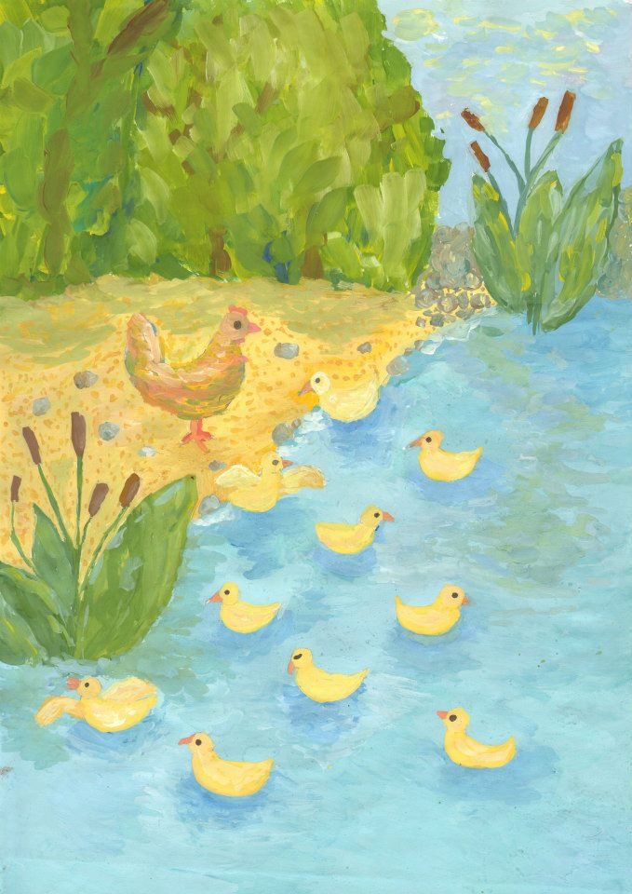
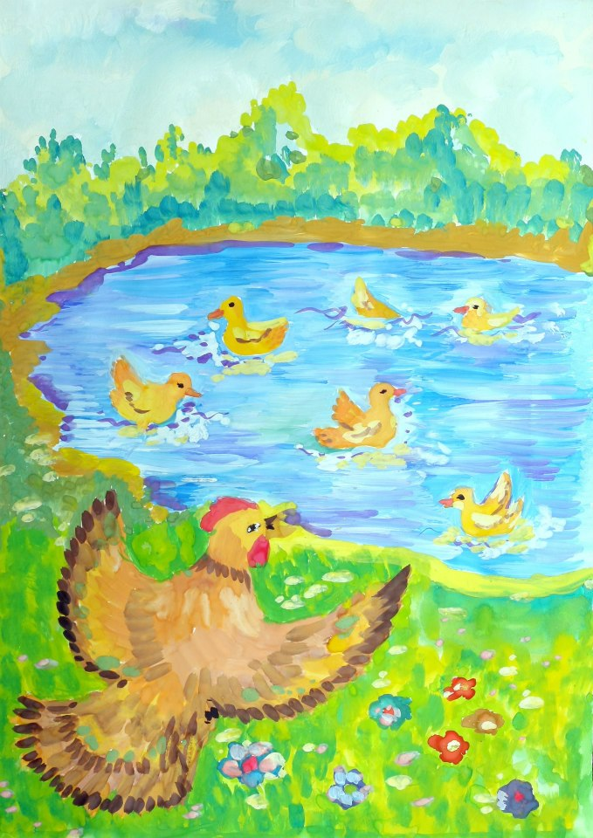

Slide 7
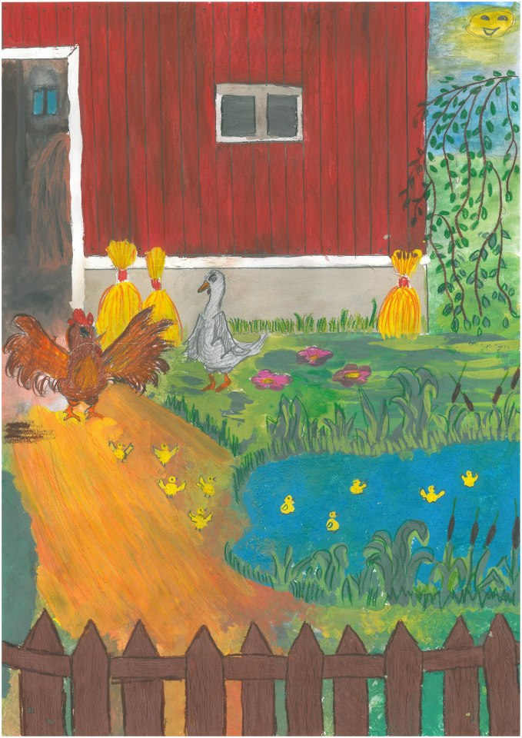
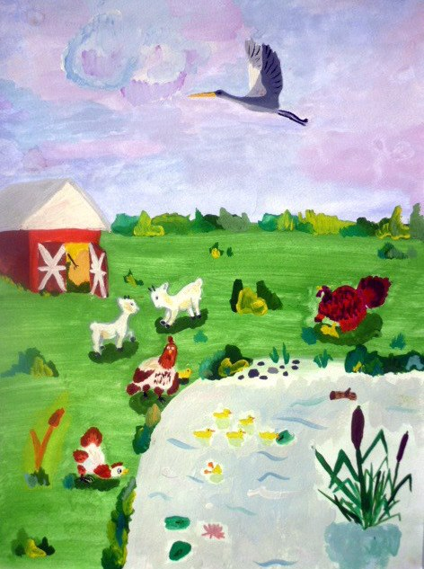

Slide 8
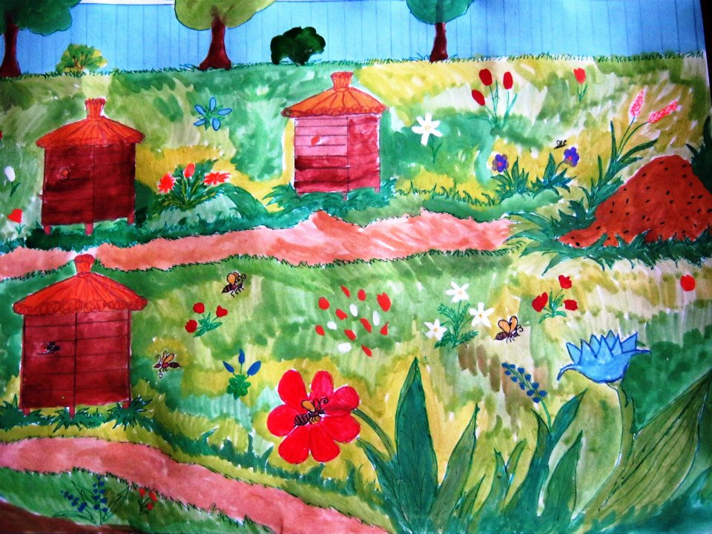
The Music of the Bees
From morning to evening in the bee garden the music of the bees rings out. You close your eyes and hear a sound like a string humming. Where is that string? Perhaps in the hives? Perhaps the little bees are sitting there and playing on some unusual instrument?

Slide 9
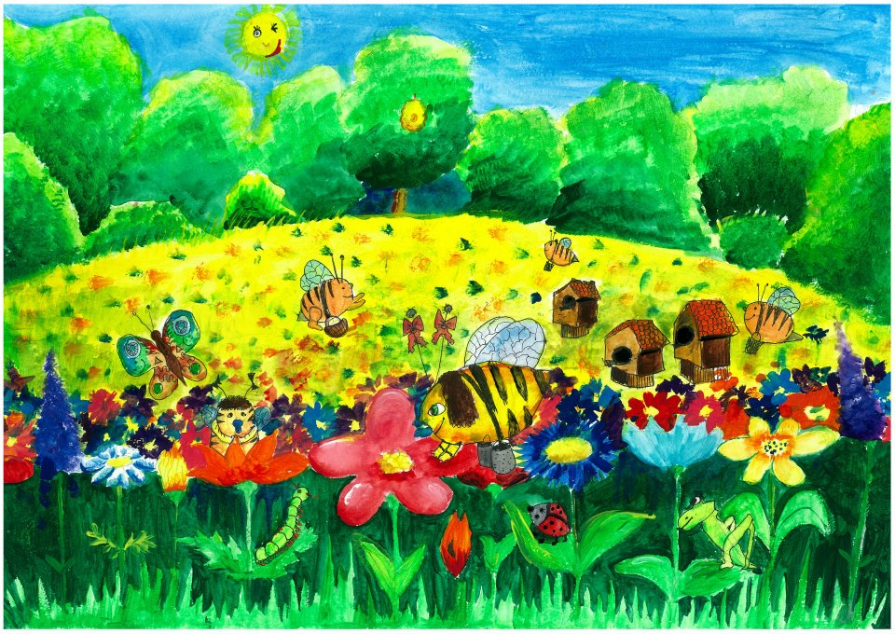
But the music is ringing everywhere, near the hives, in the garden, in the flowering buckwheat. The whole world is singing. Even the blue sky and the sun—everything is singing.

Slide 10
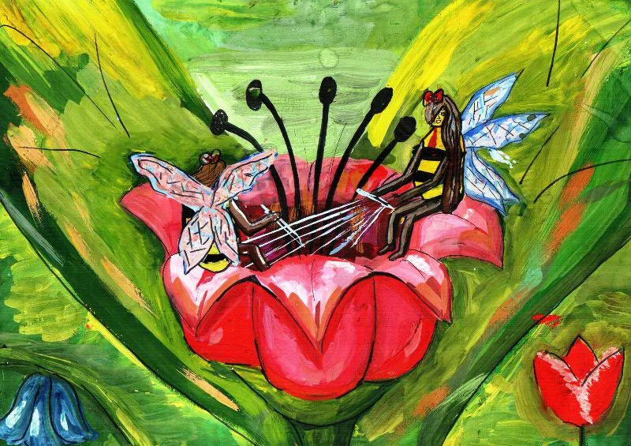
Or perhaps there are fine strings in the flowers? Perhaps the sun has stretched strings between the petals? Perhaps each bee flies up to a flower, sits between the petals and plays on those little strings with his little legs.

Slide 11
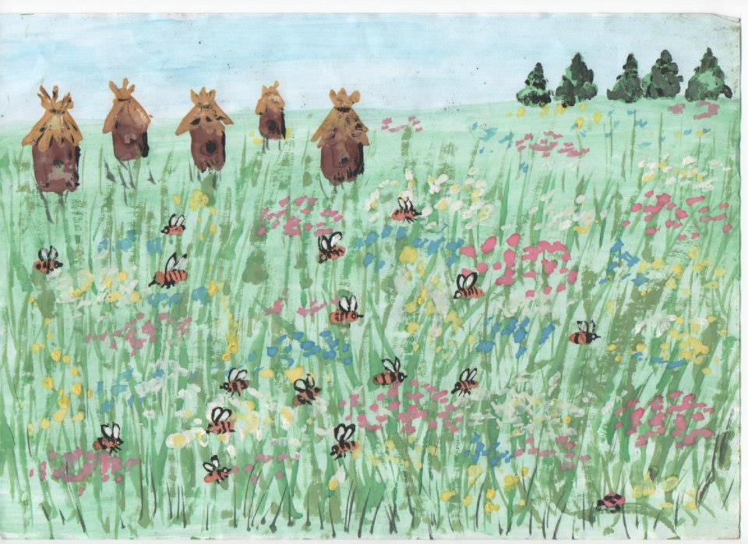

Slide 12
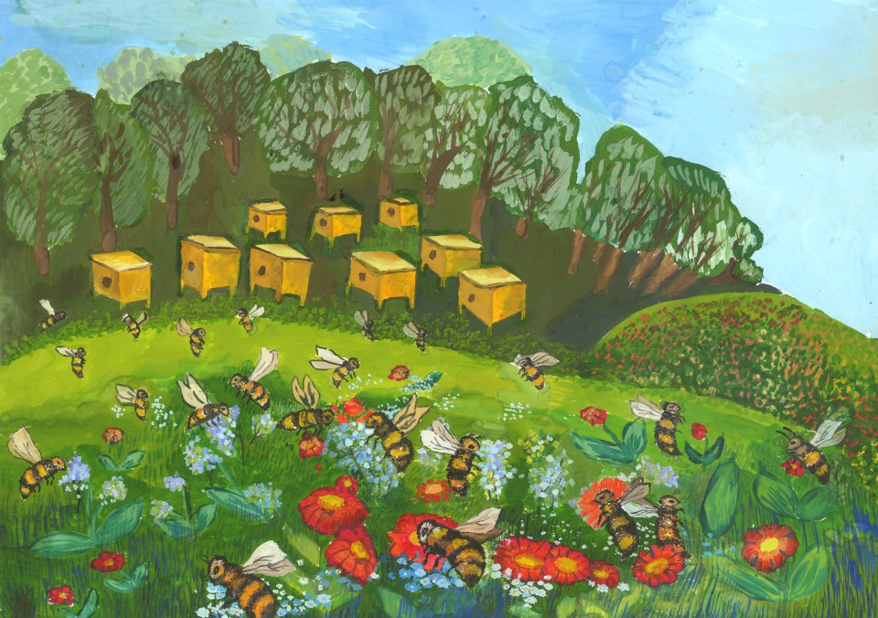

Slide 13
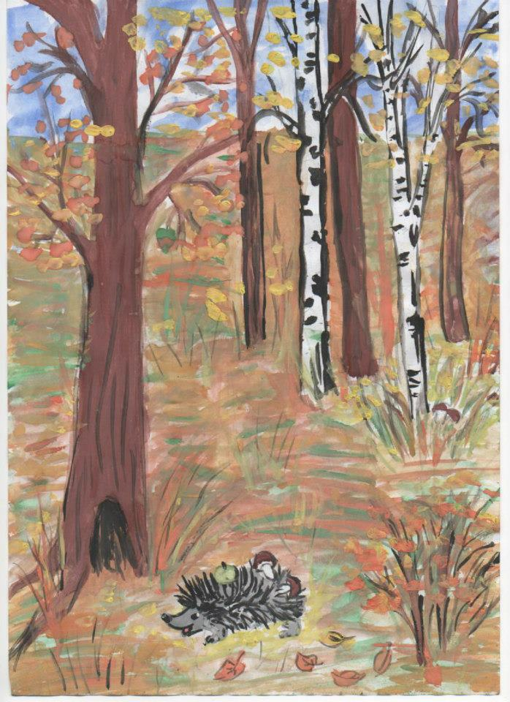
How the Hedgehog Prepared for Winter
In the forest lived a hedgehog. He made his home in the hollow of an old lime tree. It was warm there, and dry. Then autumn came. Yellow leaves fell from the trees. Soon winter would arrive.
The hedgehog began to prepare for winter. He went into the forest and collected dry leaves on his spikes. He brought the leaves to his home and spread them out so it became even warmer.

Slide 14
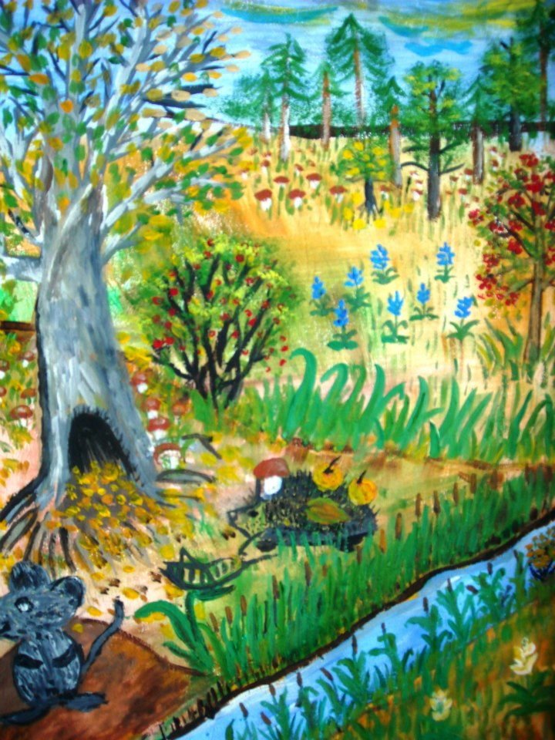
Again the hedgehog went into the forest. He gathered pears, apples and berries, carried them home on his spikes and stored them in a corner.
Once more the hedgehog went into the forest. He found mushrooms, dried them and stored them in a corner.
The hedgehog was warm and cosy, but he felt sad on his own. He wanted to find a friend. He went into the forest and met a hare. The hare did not want to come to the hedgehog’s house. Neither did the grey mouse or the gopher. They all had their own burrows.

Slide 15
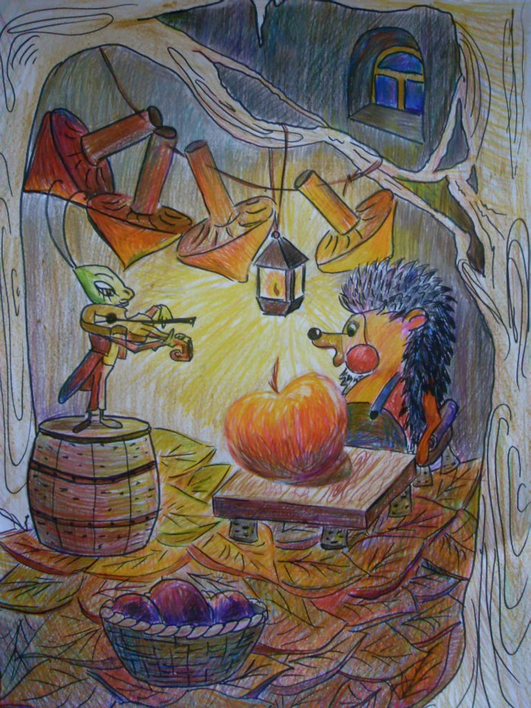
Then the hedgehog met a cricket. The cricket was clinging to a blade of grass and shivering with cold. “Come and live with me, Cricket!” said the hedgehog.
The cricket hopped to the hedgehog’s house, as pleased as could be. Winter came. The hedgehog told the cricket fairy-tales, and the cricket sang songs to the hedgehog.

Slide 16
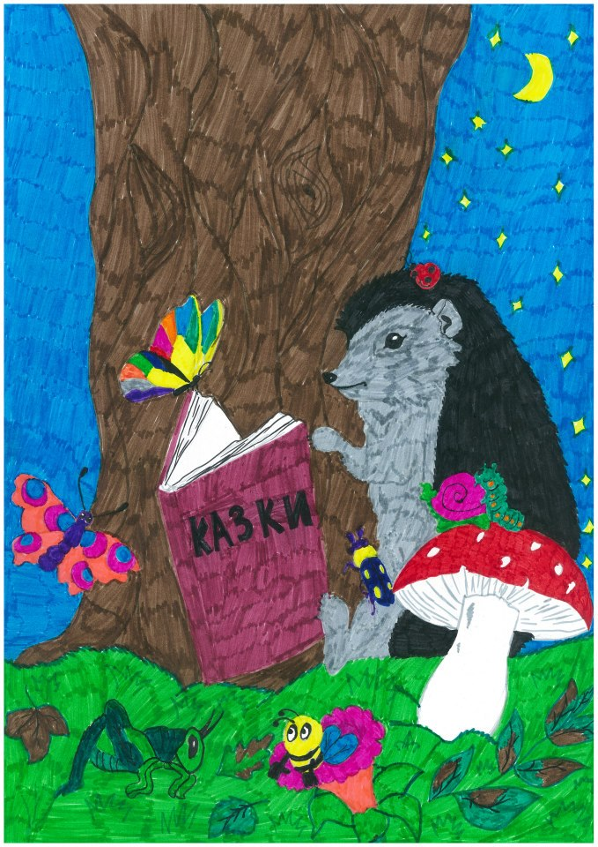
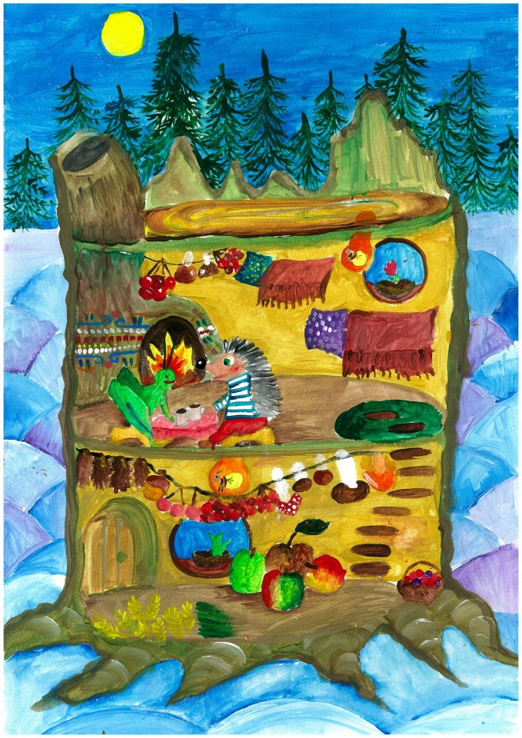

Slide 17
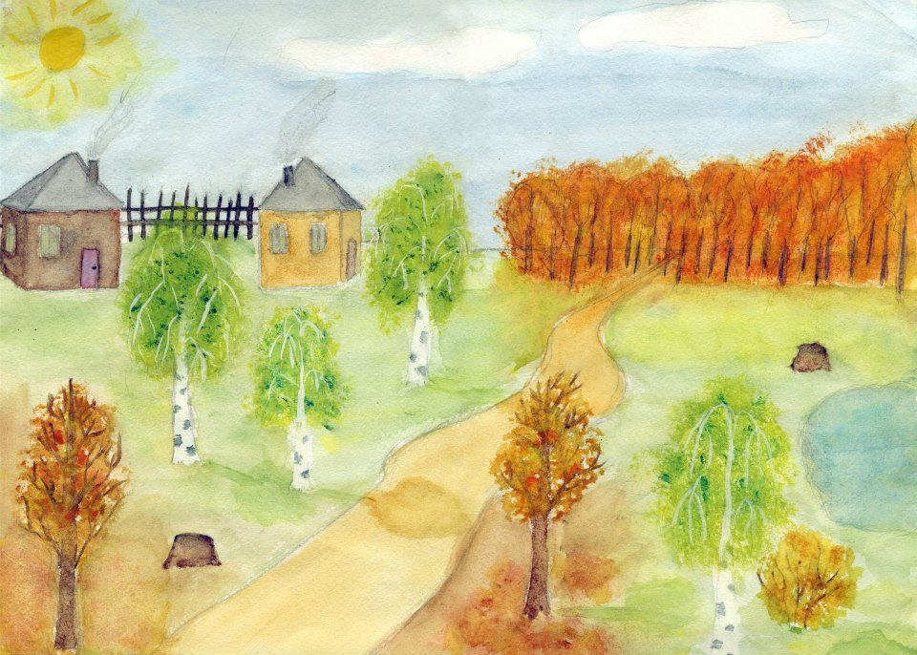
Autumn has brought Golden Ribbons
Two birch trees, tall and slim with white bark, grow by a pond. Their long green hair hangs down. The wind blows and combs their hair. The birch tree leaves whisper quietly, talking about something.

Slide 18
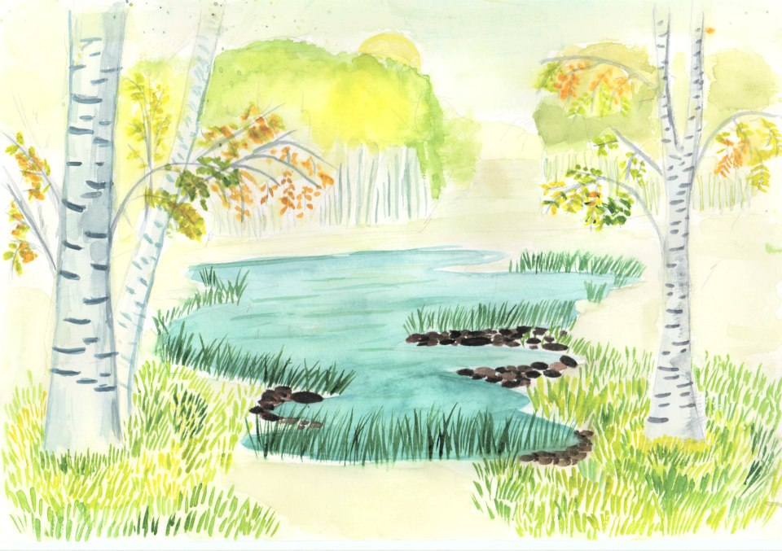
One night it turns cold. White crystals of ice shine on the grass. Autumn comes to the birch trees, bringing them golden ribbons. The birch trees plait the ribbons in their green hair.

Slide 19
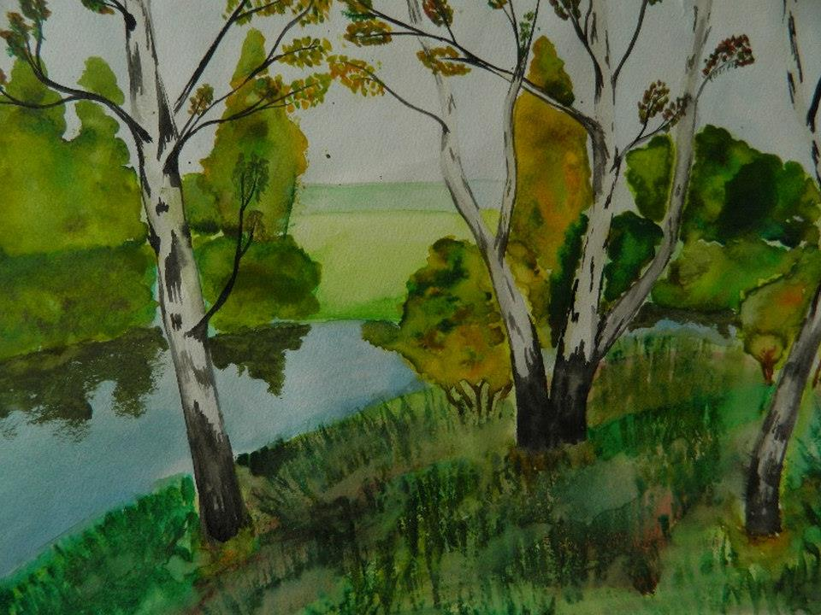
The sun rises, melting the crystals of ice. He looks at the birch trees and does not recognise them, with the golden ribbons in their hair. The sun laughs, but the birch trees are sad.

Slide 20
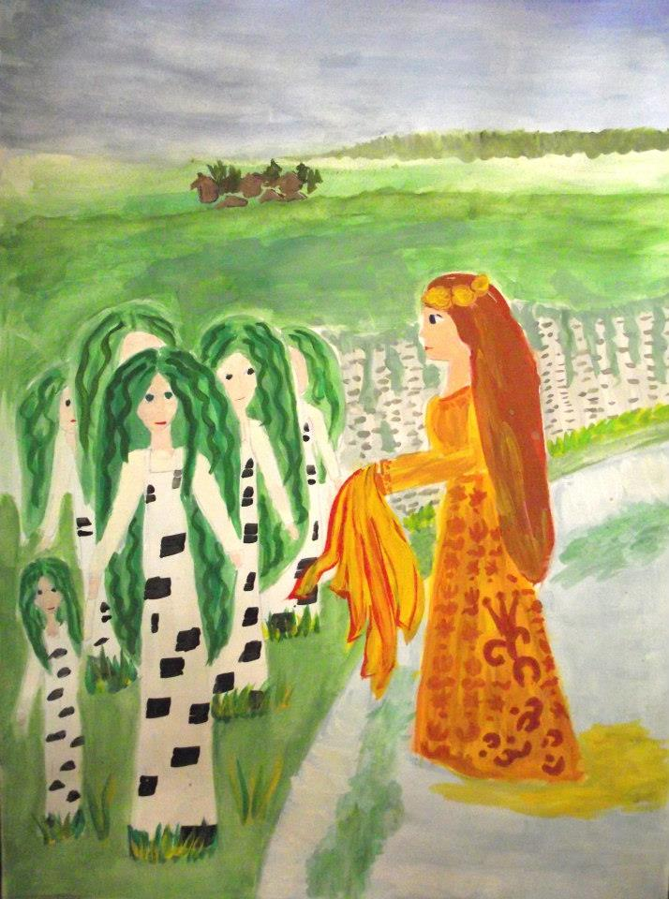
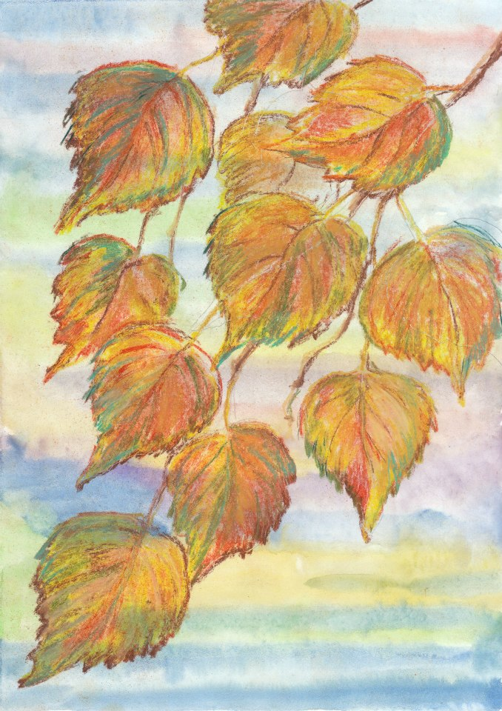

Slide 21
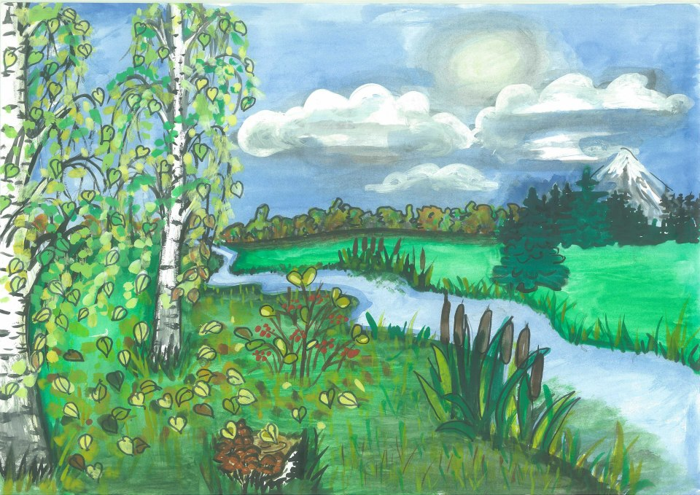

Slide 22
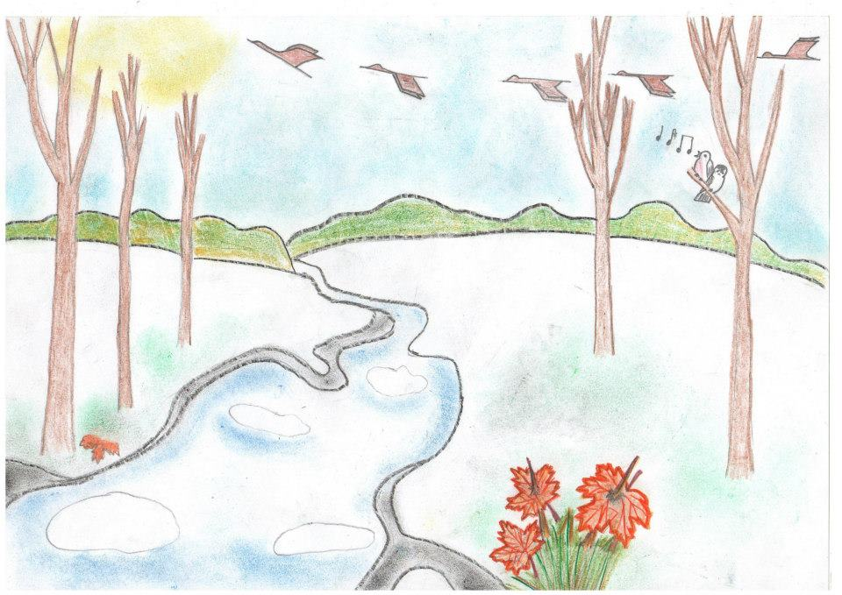
The Blade of Grass and Last Year’s Leaf
The autumn frosts hit hard. A green blade of grass wilted and lay on the ground. To make things worse, a leaf fell on it. The blade of grass lay under the leaf. A blizzard blew, and covered the ground with snow. The blade of grass was warm under the snow.

Slide 23
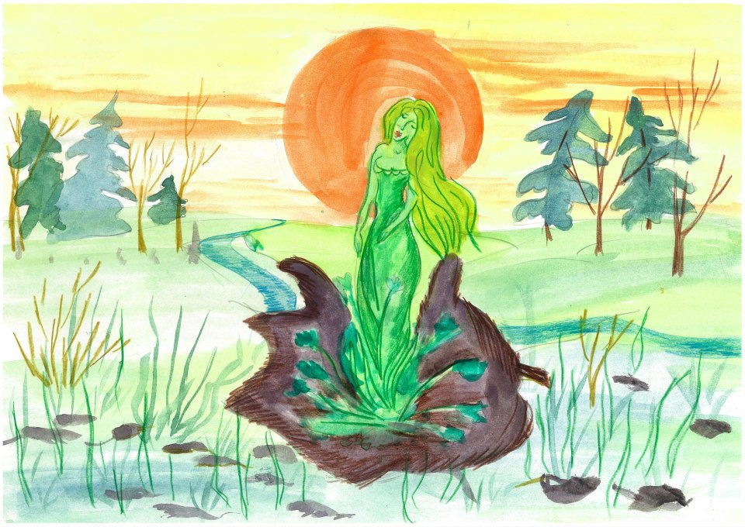
The blade of grass slept for a long time. In a dream it heard something singing above it. Something was ringing out all over the forest. The blade of grass wanted to stand up, but it could not. The dry leaf would not let it. The blade of grass gathered all its strength, rose up and poked its sharp tip through last year’s leaf.

Slide 24
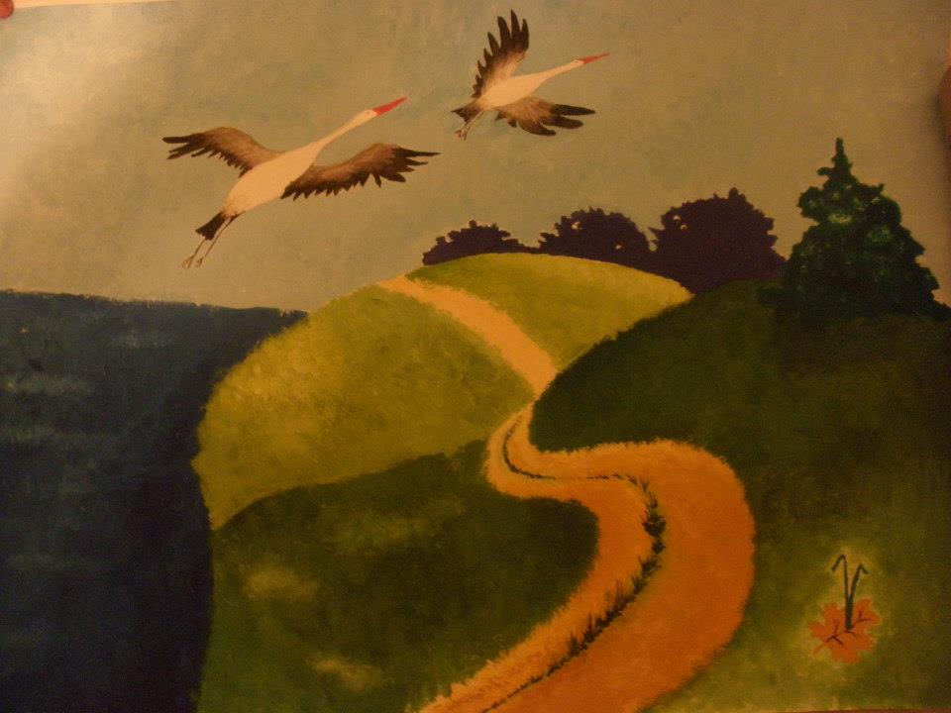
It looked around and trembled with joy. Birds were singing in the trees, spring waters were thundering in the gully, and in the blue sky the cranes were calling. “It’s spring!” thought the blade of grass, and raised itself even higher.

Slide 25
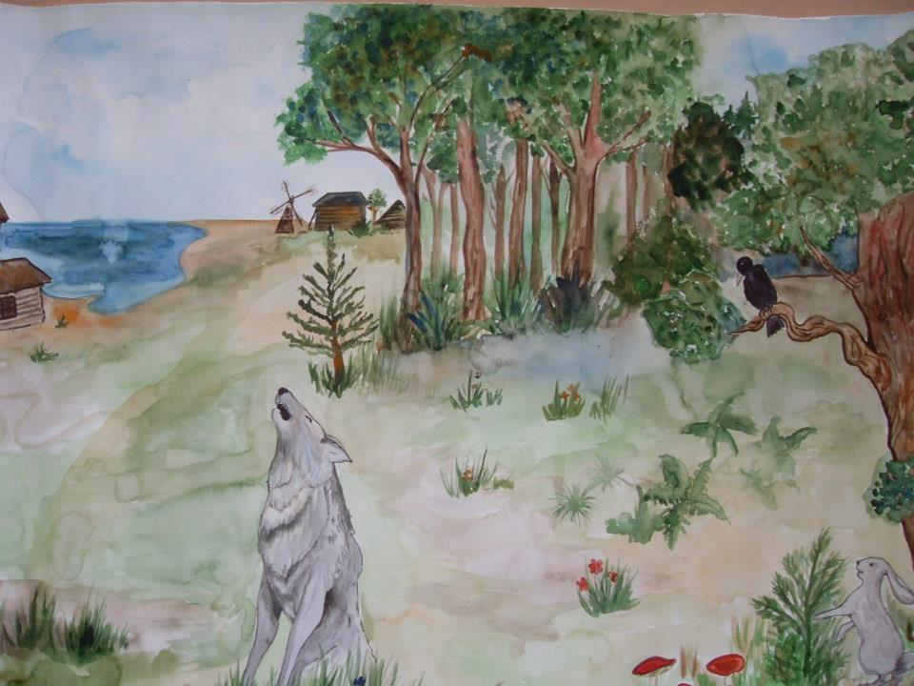

Slide 26
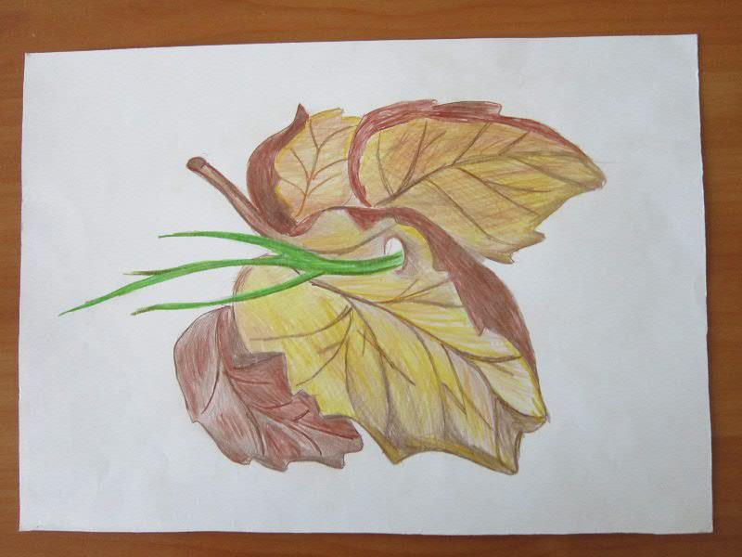

Slide 27

The Picture Book
You can buy the picture book containing 19 stories by Sukhomlynsky, illustrated by students from Ukraine and Belarus, at our online book store, Holistic Education Books:
http://holistic-education-books.com
$14.95
EJR Language Service Pty. Ltd.
An Australian company.
Copyright © 2013 EJR Language Service Pty. Ltd. All rights reserved.

